Slide 2
Do Now – (6 x 2), (3¹), (10 + 2)
Please pick up your guided notes and respond to the following SILENTLY & INDEPENDENTLY:
Write the slope-intercept form equation.
Identify all the variables in the slope-intercept form equation.
Identify the slope and y-intercept of the equation: 3x = 12y - 21

Slide 3
Weekly Agenda
Monday – Converting equations from standard form into slope intercept form.
Tuesday – Converting equations from standard form into slope intercept form.
Wednesday – Identifying x and y values on a graph.
Thursday – Linear vs nonlinear Equations.
Friday - Quiz

Slide 4
Today’s Objective
SWBAT convert an equation from standard form into slope-intercept form.

Slide 5
Converting from Standard Form to Slope-Intercept Form
As a reminder, you can not identify the slope or the y-intercept of a an equation without it being in slope-intercept form.
When converting an equation from standard form to slope-intercept form, follow these steps:
Write the equation for slope-intercept form (y = mx+ b).
Identify what term needs to be moved to make the equation look like y = mx + b.
Move terms to the correct side by changing signs when moving sides of the equal sign.
Isolate y if there is a coefficient, other than 1, by dividing both sides by the coefficient.
Simplify all terms.

Slide 6
Example 1
Watch as I walk through this one.
Convert the equation and ID the slope and y-int.
10x = -2y + 14

Slide 7
Example 2
Watch as I walk through this one.
Convert the equation and ID the slope and y-int.
-6y + 24 = -30x

Slide 8
Example 3
Walk me through this one.
Convert the equation and ID the slope and y-int.
2 = 5x – 6y

Slide 9
Example 4
Walk me through this one.
Convert the equation and ID the slope and y-int.
9x = -18 + 27y

Slide 10
Example 5
Walk me through this one.
Convert the equation and ID the slope and y-int.
-77x = 11y - 22

Slide 11
Example 6
Walk me through this one.
Convert the equation and ID the slope and y-int.
-95y = -190 – 95x

Slide 12
Example 7
Work on this one with your partner.
Convert the equation and ID the slope and y-int.
8x = 64 – 72y

Slide 13
Example 8
Work on this one with your partner.
Convert the equation and ID the slope and y-int.
-1 = 10x – 4y

Slide 14
Example 9
Work on this one with your partner.
Convert the equation and ID the slope and y-int.
-3x = -10 + 7y

Slide 15
Example 10
Work on this one on your own.
Convert the equation and ID the slope and y-int.
-3x = -10 + 7y

Slide 16
Example 11
Work on this one on your own.
Convert the equation and ID the slope and y-int.
5y = -10 + 15x

Slide 17
Example 12
Work on this one on your own.
Convert the equation and ID the slope and y-int.
7x = -28y + 9

Slide 18
Example 13
Work on this one on your own.
Convert the equation and ID the slope and y-int.
-10 = 50y + 25

Slide 19
Example 114
Work on this one on your own.
Convert the equation and ID the slope and y-int.
-9y = -36 + 45x

Slide 20
Exit Ticket
Each of you will complete your exit ticket on a note card.
You will complete the exit ticket in 5 minutes and it must be turned in before you can exit the classroom.
You must work SILENTLY and INDEPENDENTLY.
HOMEWORK – Worksheet

Slide 21
Do Now – (3² + 3¹), (√16), (√121)
Please respond to the following on your guided notes SILENTLY & INDEPENDENTLY:
Identify the slope and y-intercept: 4x = -12 + 8y
Identify the slope and y-intercept: 12x = 24y - 48

Slide 22
Today’s Agenda
SWBAT convert an equation from standard form into slope-intercept form.

Slide 23
Whiteboard Practice
Students will be given 1 minute to work through the problems on the board and identify the slope and y-intercept.
You are to work on each problem SILENTLY & INDEPENDENTLY.
Please keep your answers to yourself and write them on your guided notes when you are finished!
On the count of three, you will raise your board into the air – your answer must be boxed!
I will then go around and check your problem.
Write legibly because boards will be randomly selected for explanation.

Slide 24
Example 1
-10 = 20x + 5y

Slide 25
Example 2
-21 = 7x -14y

Slide 26
Example 3
9y = 36 – 18x

Slide 27
Example 4
-15x = 30y - 10

Slide 28
Example 5
2x -4y = 8

Slide 29
Example 6
3y = 12 – 6x

Slide 30
Example 7
8x = -16y + 32

Slide 31
Example 8
20x = 40y - 20

Slide 32
Example 9
6x + 3y = -24

Slide 33
Example 10
8x = 2y + 32

Slide 34
Example 11
-15x – 30 = 5y

Slide 35
Example 12
28 – 14y = 7x

Slide 36
Example 13
-6x + 12 = 3y

Slide 37
Example 14
16 = 32x – 8y

Slide 38
Example 15
4x = 12y + 16

Slide 39
Example 16
30 = -60x + 15y

Slide 40
Example 17
12y = -24 + 6y

Slide 41
Example 18
-15x = 30 - 3y

Slide 42
Example 19
22x = 88 – 11y

Slide 43
Example 20
-75 = 25x + 5y

Slide 44
Exit Ticket
Each of you will complete your exit ticket on a note card.
You will complete the exit ticket in 5 minutes and it must be turned in before you can exit the classroom.
You must work SILENTLY and INDEPENDENTLY.
HOMEWORK – Worksheet

Slide 45
Exit Ticket

Slide 46
Do Now – (√144), (√25), (10 + 2)
Please respond to the following on your guided notes SILENTLY & INDEPEDENTLY:
Identify the slope and y-intercept -12 = 24x + 48y
What is the slope of a line that passes through (-10,5) & (20 – 15)?

Slide 47
Today’s Objective
SWBAT identify the coordinate of the y-intercept and the x value of a graph.

Slide 48
Identifying Coordinates & Values
On the tcap, they will ask for the ordered pair of the y-intercept.
The y-intercpet is always on the y-axis so the ordered pair always has a 0 for the x coordinate and the y coordinate is wherever the graph crosses the y-axis. (i.e. (0, y-int).
The ordered pair for the y-intercept to the right is (0,2).

Slide 49
Identifying Coordinates & Values
Furthermore, the TCAP will have you identify x values on the graph.
To find the y values, look at the x-value identified and determine the corresponding y value on the graph.
Or, you can sub the x-value into the equation of the graph and solve for y.
Example: If x = 2, what is the value of y?
Answer: x = 8
Answer: y = 3x + 2 → sub 2 in for x and solve for y to get 8.

Slide 50
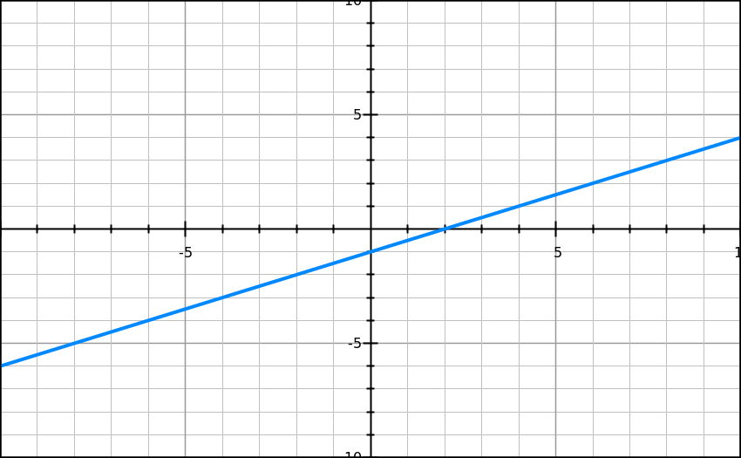
Example 1 – Watch as I walk through this one.
Write the ordered pair for the y-intercept.
When x = -4, what is y?

Slide 51
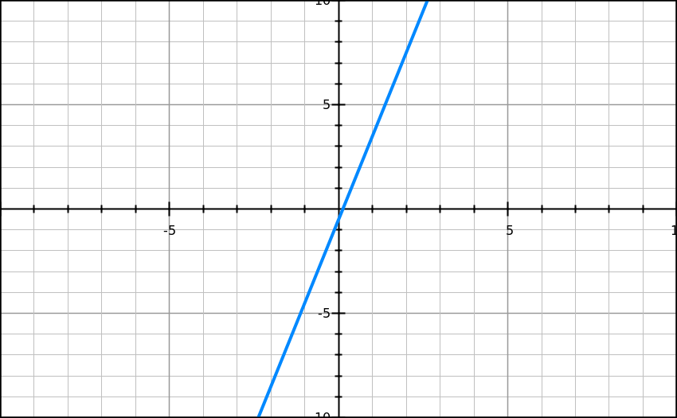
Example 2 – Watch as I walk through this one.
Write the ordered pair for the y-intercept.
When x = 1, what is y?

Slide 52
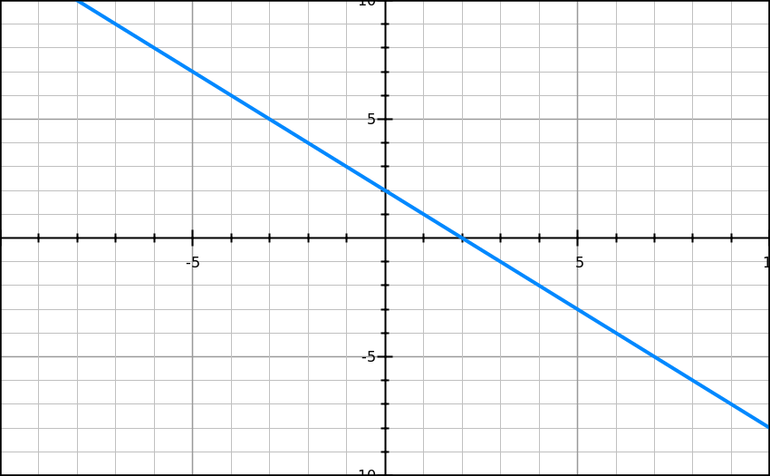
Example 3 – Watch as I walk through this one.
Write the ordered pair for the y-intercept.
When x = -4, what is y?

Slide 53
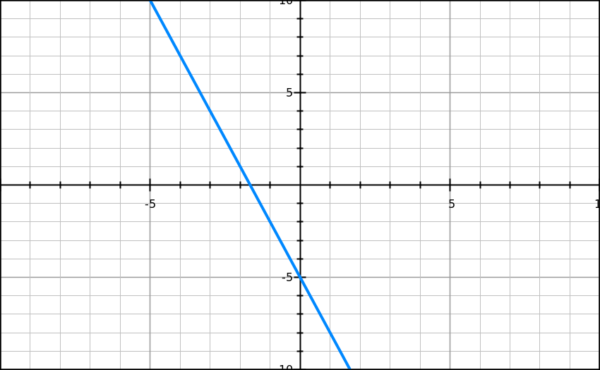
Example 4 – Walk me through this one.
Write the ordered pair for the y-intercept.
When x = 1, what is y?

Slide 54
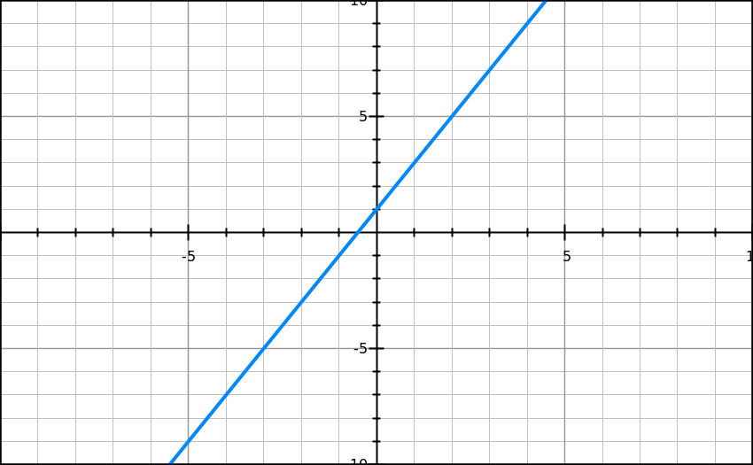
Example 5 – Walk me through this one.
Write the ordered pair for the y-intercept.
When x = 4, what is y?

Slide 55
Example 6 – Work on this one with your partner.
Write the ordered pair for the y-intercept.
When x = -3, what is y?

Slide 56
Example 7 – Work on this one with your partner.
Write the ordered pair for the y-intercept.
When x = 2, what is y?

Slide 57
Example 8 – Work on this one with your partner.
Write the ordered pair for the y-intercept.
When x = 2, what is y?

Slide 58
Example 9 – Work on this on your own.
Write the ordered pair for the y-intercept.
When x = 2, what is y?

Slide 59
Example 10 – Work on this on your own.
Write the ordered pair for the y-intercept.
When x = ½, what is y?

Slide 60
Example 11 – Work on this on your own.
Write the ordered pair for the y-intercept.
When x = -3, what is y?

Slide 61
Example 12 – Work on this on your own.
Write the ordered pair for the y-intercept.
When x = 2, what is y?

Slide 62
Exit Ticket
Each of you will complete your exit ticket on a note card.
You will complete the exit ticket in 5 minutes and it must be turned in before you can exit the classroom.
You must work SILENTLY and INDEPENDENTLY.
HOMEWORK – Worksheet

Slide 63
Exit Ticket

Slide 64
Do Now – (6 x 2), (3 x 2), (4 + 8)
Please take out your guided notes and respond to the following SILENTLY & INDEPENDENTLY:
Identify the slope and y-intercept. 5x = 10y – 50
Write the coordinate for the y-intercept.
When x = 1.5, what is y?

Slide 65
Today’s Objective
SWBAT identify a function as linear or nonlinear based off of an equation or graph.
I LOVE functions!

Slide 66
Functions: Linear or Nonlinear
As a reminder, let’s go over the definition of a function.
Function: A relationship between x and y where each x value has only 1 y value.
Functions can be 2 different types:
Linear
Nonlinear

Slide 67
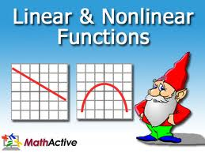
Functions: Linear or Nonlinear
Linear Function: A function that forms a straight line when graphed.
ID’d by the following formula: y = mx + b
Where the variables DO NOT HAVE an exponent other than 1.
Ex: y = 2x - 7
Nonlinear Function: A function that does not result in a straight line when graphed.
ID’d by any equation where THERE IS an exponent on x or y.
Ex: y = 2x² + 4

Slide 68
Functions: Linear or Nonlinear
Linear Function
y = 2x - 7
Nonlinear Function
y = 2x² - 7

Slide 69
Functions: Linear or Nonlinear
This makes sense when the equations are graphed, watch as these are graphed.
Linear Function
y = 2x + 2
Nonlinear Function
y = x² - 2

Slide 70
Functions: Linear or Nonlinear
Walk me through this example.
Example 1: Is this linear or nonlinear? How do you know?

Slide 71
Functions: Linear or Nonlinear
Walk me through this example.
Example 2: Is this linear or nonlinear? How do you know?

Slide 72
Functions: Linear or Nonlinear
Walk me through this example.
Example 3: Is this linear or nonlinear? How do you know?

Slide 73
Functions: Linear or Nonlinear
Walk me through this example.
Example 4: Is this linear or nonlinear? How do you know?
y³ = 5x

Slide 74
Functions: Linear or Nonlinear
Walk me through this example.
Example 5: Is this linear or nonlinear? How do you know?
y = x³ + 2

Slide 75
Functions: Linear or Nonlinear
Complete this one WITH YOUR PARTNER.
Example 6: Is this linear or nonlinear? How do you know?
y = -x - 7

Slide 76
Functions: Linear or Nonlinear
Complete this one WITH YOUR PARTNER.
Example 7: Is this linear or nonlinear? How do you know?
y = ½x² -8

Slide 77
Functions: Linear or Nonlinear
Complete this one ON YOUR OWN.
Example 8: Correctly pair the equation with the graph.
a) y = ¼x - 10
b) y = 2x² + 2

Slide 78
Functions: Linear or Nonlinear
Complete this one ON YOUR OWN.
Example 9: Correctly pair the equation with the graph.
a) y = ½x - 3
b) y = -½x -3

Slide 79
Functions: Linear or Nonlinear
Agree (Thumbs UP) or Disagree (Thumbs DOWN) with the following statement.
Example 10: A linear function can be identified by an equation (y = mx + b) where x has an exponent of 2 or greater.

Slide 80
Functions: Linear or Nonlinear
Agree (Thumbs UP) or Disagree (Thumbs DOWN) with the following statement.
Example 11: A nonlinear function looks like a line when graphed.

Slide 81
Quiz Overview
Topics on BIG QUIZ!
Identifying slope and y-intercept.
Converting equations from standard form to slope intercept form.
Writing equations given a graph.
Identifying the ordered pair of the y-intercept.
Identifying the y value, given an x value.
Identifying equations and pictures as linear or nonlinear.

Slide 82
Exit Ticket
Each of you will complete your exit ticket on a note card.
You will complete the exit ticket in 5 minutes and it must be turned in before you can exit the classroom.
You must work SILENTLY and INDEPENDENTLY.
HOMEWORK – Worksheet

Slide 83
Exit Ticket

Slide 84
Do Now – (12¹), (21/3), (6 + 6)
Please clear off your desk of everything except your pencil, your calculator, and a plain sheet of paper.
The longer it takes you to do this, the less time you will have for your quiz!

