Slide 1
Unit 8, Week 2 - Angles
SPI 3.4

Slide 2
Do Now – (√1), (21/3), (√169)
Please pick up your notes and tracker!
Write the equation for the Pythagorean theorem and identify each variable in the equation.
Write an expression of how you would find the length of leg n? – DO NOT SOLVE!
Write a triplet of numbers that represent the lengths of a right triangle and satisfy the Pythagorean theorem.
11
n
5

Slide 3
Do Now – (√1), (21/3), (√169)
Write the equation for the Pythagorean theorem and identify each variable in the equation.
Write an expression of how you would find the length of leg n? – DO NOT SOLVE!
11
n
5

Slide 4
Do Now – (√1), (21/3), (√169)
Write a triplet of numbers that represent the lengths of a right triangle and satisfy the Pythagorean theorem.

Slide 5
100% Math All-Stars!
3rd Period
Mackenzie
Cordarius
Carlos
Quinterio
5th Period
Torez
Katelyn
Aliyah
Robynn
Mario
6th Period
Dorian C.
Antonio
7th Period
Autumn
Lataryl
Cynthia
Willie

Slide 6
85% or High Mathletes
3rd Period
Kiara
Jacob J.
Tyler R.
5th Period
Tristan
Lekendric
Tyun
Abduk
Kaylan
Brandon
Olivia
Christian
Belen
Anneliese
JuWaun
Vicki
Wesley
Ceirsten
6th Period
Quinton
Shatonya
Darius
Tylesha
Josh
Jaycee
Greg
Jayla
Jim
Brittni
7th Period
Grace
Jasmin
Khadija
Shaquanna
Kameron
Chris
Jordan

Slide 7
Unit 5, Quiz 1 Averages

Slide 8
Weekly Agenda
Monday – Angle Definitions
Tuesday – Vocabulary Quiz & Finding the Missing Angle
Wednesday – Finding the Missing Angle
Thursday – Angles Review
Friday - Quiz

Slide 9
Today’s Agenda
Do Now – 10 minutes
Shout Outs/Tracking – 5 minutes
Brain Pop – 3 minutes
Angle Definitions – 22 minutes
Angle Identification – 10 minutes

Slide 10
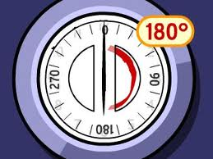
Today’s Objective
SWBAT define and identify transversals, parallel lines, alternate interior angles, corresponding angles, alternate exterior angles, complementary angles, supplementary angles, and straight angles.

Slide 11
BrainPOP!
BrainPOP! - Angles

Slide 12
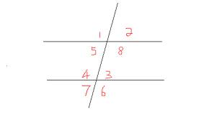
Angles
Every triangle and geometric shape we encounter is made of angles. As long as we know the measurement of one angle, we can find the measurement of many other angles.
Today, we will introduce angles and identify the type of angle given.
This week, we will work with angles more and determine the missing angle given an angle.

Slide 13
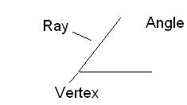
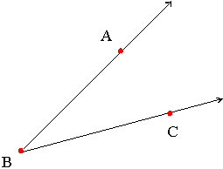
Angles
Let’s go over some new vocabulary words before we begin.
Angle: Formed by two rays that share a vertex or the same endpoint.
There are 3 ways to name an angle:
Angle ABC or ABC
Angle CBA or CBA
Angle B or B

Slide 14
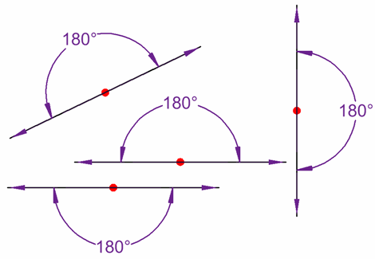
Angles
Straight Angle: An angle with a measure of 180°.
Looks like a straight line.

Slide 15
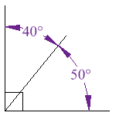
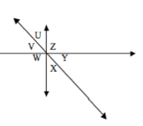
Angles
Complementary Angles: Two angles that have a combined measure of 90°.
Look for a right angle to help identify.
Angle U & Angle V are complementary.
Angle Y & Angle X are complementary.

Slide 16
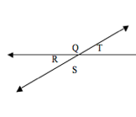
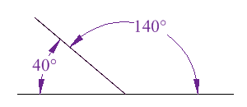
Angles
Supplementary Angles: Two angles that have a combined measure of 180°.
Look for a straight angle to help identify.
Angles Q & T are supplementary.
Angles R & S are supplementary.

Slide 17
Example 1
Identify as complementary, supplementary, or neither.
120º
60º

Slide 18
Example 2
Identify as complementary, supplementary, or neither.
60º
30º

Slide 19
Example 3
Identify as complementary, supplementary, or neither.
75º
75º

Slide 20
Example 4
Identify as complementary, supplementary, or neither.
25º
65º

Slide 21
Example 5
Identify as complementary, supplementary, or neither.
60º
40º

Slide 22
Example 6
Identify as complementary, supplementary, or neither.
90º
50º

Slide 23
Example 7
Identify as complementary, supplementary, or neither.
Measure of angle 1: 110°
Measure of angle 2: 70°

Slide 24
Example 8
Identify as complementary, supplementary, or neither.
Measure of angle 1: 22°
Measure of angle 2: 68°

Slide 25
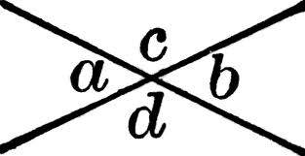
Angles
Transversal: a line that crosses other lines at different points.
Diagram: line intersecting L & M
Parallel Lines: Lines in the same plane that never meet or intersect.
Diagram: L & M
Congruent (≅): Equal
Vertical Angles: Two nonadjacent angles formed by intersecting lines that are CONGRUENT.
These angles are ACROSS FROM EACH OTHER.
Diagram Above: Angles 1 & 8, Angles 4 & 6
A & B are vertical, C & D are vertical.
L
M

Slide 26
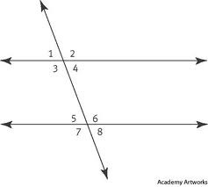
Angles
Interior Angles: Angles that lie between the parallel lines.
These are NOT CONGRUENT.
Angles 3, 4, 5, & 6
Exterior Angles: Angles that lie outside the parallel lines.
These are NOT CONGRUENT.
Angles 1, 2, 7, 8

Slide 27
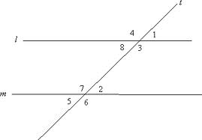
Example 9
Identify angles that are vertical.

Slide 28
Example 10
Identify the interior angles.

Slide 29
Example 11
Identify the exterior angles.

Slide 30
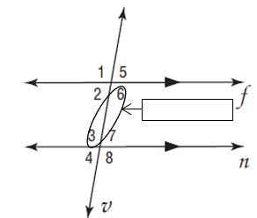
Angles
Alternate Interior Angles: Angles that lie inside the parallel lines and are on opposite sides of the transversal.
These are CONGRUENT!
6 & 3 are alt. int., 2 & 7 are alt. int.
Alt. Interior

Slide 31
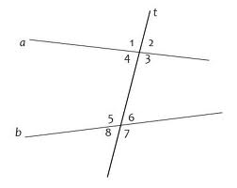
Example 12
Identify the sets of alternate interior angles.

Slide 32
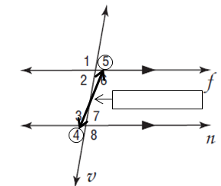
Angles
Alternate Exterior Angles: Angles that lie outside the parallel lines and are on opposite sides of the transversal.
These angles are CONGRUENT!
4 & 5 are alt. ext.
1 & 8 are alt. ext.
Alt. Exterior

Slide 33
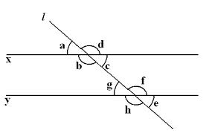
Example 13
Identify the sets of alternate exterior angles.

Slide 34
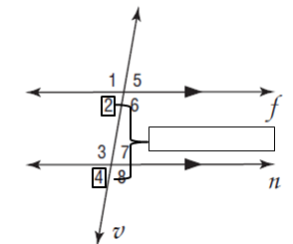
Angles
Corresponding Angles: One angle lies outside the parallel lines and one angle lies inside the parallel lines.
Both are on the same side of the transversal.
These are CONGRUENT!
2 & 4 are corresponding
1 & 3 are corresponding
Corresponding

Slide 35
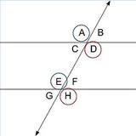
Example 14
Identify the sets of corresponding angles.

Slide 36
Homework:
Study for your vocab quiz!

Slide 37
Do Now – (-4+3), (24/3), (26/2)
Clear your desk off and prepare for your vocabulary quiz!

Slide 38
Today’s Agenda
Vocabulary Quiz – 12 minutes
Finding the Missing Angles INM – 20 minutes
Finding the Missing Angles GP – 18 minutes

Slide 39
Today’s Objective
SWBAT find the missing measure of the angle given a diagram.

Slide 40
Finding the Missing Measure of an Angle
Now that we understand the definitions and have seen what the definitions mean on a diagram, we are going to apply them to determine the missing measures of angles.
On your notes, you will see a diagram and then a box. In the box, we will fill in the missing angle measurement, but also put the proof that allowed us to determine that measurement. This will really help us apply our definitions!

Slide 41
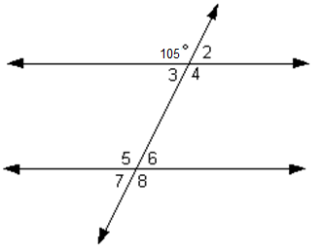
Example 1
Angle Measurement | Reason
Given: 105° | Given.
∠2 =
∠3 =
∠4 =
∠5 =
∠6 =
∠7 =
∠8 =

Slide 42
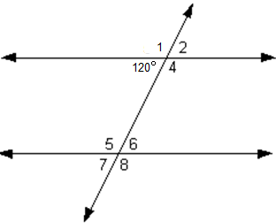
Example 2
Angle Measurement | Reason
Given: 120° | Given.
∠1 =
∠2 =
∠4 =
∠5 =
∠6 =
∠7 =
∠8 =

Slide 43
Identifying & Finding Angles Worksheet
Today, you will be working on a worksheet to identify the different types of angles (the ones you studied last night!) and finding the measurements of all the angles in the diagram.
You may work with your partner on this worksheet and I will circulate throughout the room to help you if necessary.
You will continue working on this tomorrow also, so please don’t rush!

Slide 44
Exit Ticket

Slide 45
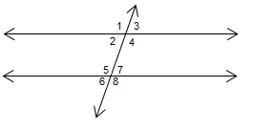
Do Now – (-1 x -1), (√81), (6+7)
Name a pair of alternate interior angles.
Name a pair of alternate exterior angles.
Name a pair of vertical angles.
Determine the measurement of Angle 4.
97°

Slide 46
Today’s Objective
SWBAT find the missing measure of the angle given a diagram.

Slide 47
Example 1
Please look at your guided notes as we review this example before working with your partner.
B
C
BD
E
F
G
H

Slide 48
Identifying & Finding Angles Worksheet
Today, you will be working on the worksheet from yesterday.
Today, you will be able to work with your partner for ½ the time and then independently for the other half.
Like yesterday, I will be circulating around the room to help you if necessary.
Use your time wisely, this will be due at the end of the class!

Slide 49
Exit Ticket

