Slide 1
Unit 4, Week 1
Functions and Slope – SPI 3.5

Slide 2
Do Now - √121, √169, √144
Please pick up your guided notes and respond to the following SILENTLY & INDEPENDENTLY:
Identify the x and y coordinates for the ordered pair: (-5, 7)
Where is the x-axis – horizontal or vertical?
Where is the y-axis – horizontal or vertical?
Write anything you know about slope.

Slide 3
Today’s Objective
SWBAT define a linear function.
SWBAT identify a function as linear from points, table, or pictures.

Slide 4
Weekly Agenda
Tuesday – Linear Functions
Wednesday – Slope from a table or points
Thursday – Slope from a graph
Friday - Quiz

Slide 5
Functions
Function: A relationship between an ordered pair (x.y) where each x value has only 1 y value.
Most functions correspond to a specific equation.
Each time you substitute a value in for x in that equation, you will only get 1 y value.
Linear Function: A function that is a line when graphed.

Slide 6
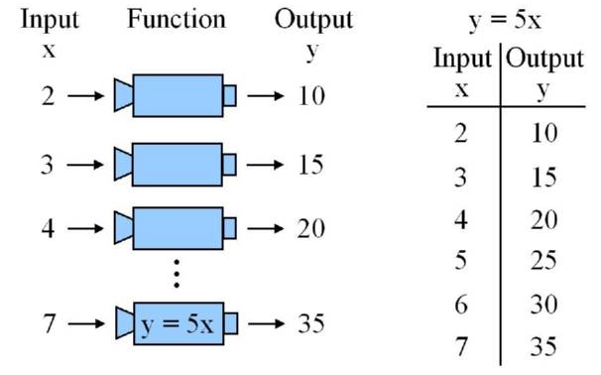
Functions
When you think of functions as a machine, there is always something you put in to get your product.
Think of what you put in as the INPUT. The input of a function is the X VALUE.
Think of what you get out of the machine as the OUTPUT. The output of a function is the Y VALUE.

Slide 7
Functions
Think of the x value as boys and the y value as girls.
For every boy, there can only be 1 girlfriend!
For every x there can only be 1 y!
Justin Bieber can only have 1 girlfriend! Otherwise, he is not a function!

Slide 8
Functions
The definition of a function states that each x value has exactly 1 y value.
If an x value has more than 1 output, it is NOT A FUNCTION.
Is this a function?
YES!
y=2x
X Value | Y Value
-2 | -4
-1 | -2
0 | 0
1 | 2
2 | 4
input
output
Example 1

Slide 9
Functions
The definition of a function states that each x value has exactly 1 y value.
If an x value has more than 1 output, it is NOT A FUNCTION.
Is this a function?
y= students favorite color
input
X Value | Y Value
Brandon | Blue
Josh | Green
Dasha | Blue
Khylee | Purple
Darius | Green
output
Example 2

Slide 10
Functions
The definition of a function states that each x value has exactly 1 y value.
If an x value has more than 1 output, it is NOT A FUNCTION.
Is this a function?
input
X Value | Y Value
1 | -7
2 | -3
3 | 5
4 | 7
5 | -3
output
Example 3

Slide 11
Functions
The definition of a function states that each x value has exactly 1 y value.
If an x value has more than 1 output, it is NOT A FUNCTION.
Is this a function?
y= |x|
input
X Value | Y Value
-10 | 10
-2 | 2
-1 | 1
10 | 10
2 | 2
output
Example 4

Slide 12
Functions
Example 5
:Work on this one with your partner.
X Value | Y Value
0 | 5
1 | 5
2 | 5
3 | 5
0 | 5

Slide 13
Functions
Example 6:
Work on this one with your partner.
X Value | Y Value
-3 | 3
-3 | 5
-2 | 2
-2 | -2
-1 | 5

Slide 14
Functions
Example 7: Work on this one on your own.
We’ll review in a few seconds
X Value | Y Value
-2 | 1
-3 | 1
-1 | 6
4 | 5
-3 | 1

Slide 15
Functions
Example 8: Work on this one on your own.
We’ll review in a few seconds.
X Value | Y Value
-2 | 3
-2 | 4
-1 | 5
0 | 6
1 | 7

Slide 16
Functions
Example 9:
Does the following represent a function?
{ (-9,8), (10,12), (9, 7), (8,7), (-5,3), (4, 3) }

Slide 17
Functions
Example 10:
Does the following represent a function?
{ (5,7), (6,7), (8, 7), (9,7), (10,7), (11, 7) }

Slide 18
Functions
Example 11:
Does the following represent a function?
{ (-3,4), (-4,5), (-4, 4), (-5, 5), (-6,7), (-7, 7) }

Slide 19
Functions
Example 12:
Does the following represent a function?
{ (2,5), (3,6), (4, 3), (5, 5), (6,7), (7, 7) }

Slide 20
Functions
Example 13:
Does the following represent a function?
{ (8,7), (9,6), (4, 3), (2, 5), (10,7), (-7, 7) }

Slide 21
Functions
Example 14:
Does the following represent a function?
{ (3,7), (7,6), (2, 3), (1, 5), (10,7), (-7, 7) }

Slide 22
Functions
Example 15:
Does the following represent a function?
{ (5,7), (7,6), (12, 3), (26, 8), (8,26), (-7, 12) }

Slide 23
Functions
Example 16:
What coordinate could be added to the group to make it a function?
{ (-5,3), (6, 7), (10, 12), (8, 2) }
(-3, 7)
(6, 4)
(-5, 7)
(6, 8)

Slide 24
Functions
Example 17:
What coordinate could be added to the group to make it a function?
{ (8,12), (-6, 15), (6, 15,), (6, 42) }
(8, 12)
(-6, 7)
(6, 4)
(6, 8)

Slide 25
Functions
Example 18:
What coordinate could be added to the group to make it a function?
{ (9,13), (4, 1), (2, 6), (8, 2) }
(8, 12)
( 7, 5)
(2, 1)
(8, 8)

Slide 26
Functions
Example 19:
What coordinate could be added to the group to make it a function?
{ (7, 10), (-4, 5), (8, 6), (14, 3) }
(8, 12)
( 7, 5)
(2, 1)
(8, 8)

Slide 27
Functions
Example 20:
What coordinate could be added to the group to make it a function?
{ (14, 6), (3, 8), (2, 9), (11, 5) }
(6, 8)
( 3, 5)
(2, 1)
(14, 8)

Slide 28
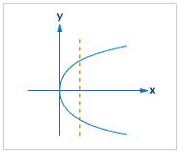
Functions – The Vertical Line Test
We said a function can only have 1 y value for each x value, therefore, if we look at a graph and more than one y value corresponds to an x value, the graph is not a function.
The vertical line test helps us figure this out.
The vertical line test states: if you draw a vertical line (up and down) through the graph and it touches more than one point on the graph, it is not a function!

Slide 29
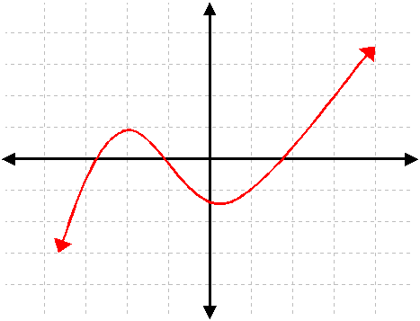
Functions – The Vertical Line Test
Example 21:
Is this graph a function?

Slide 30
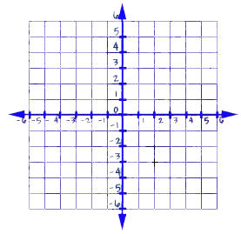
Functions – The Vertical Line Test
Example 22:
Is this graph a function?

Slide 31
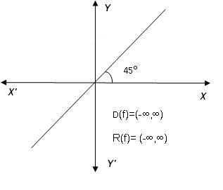
Functions – The Vertical Line Test
Example 23: Work on this one with your partner.
Is this graph a function?

Slide 32
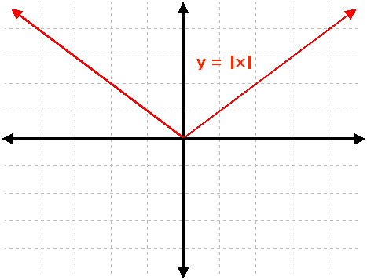
Functions – The Vertical Line Test
Example 24: Work on this one with your partner.
Is this graph a function?

Slide 33
Functions – The Vertical Line Test
Example 25: Work on this one on your own.
Is this graph a function?

Slide 34
Functions – The Vertical Line Test
Example 26: Work on this one on your own.
Is this graph a function?

Slide 35
Functions – The Vertical Line Test
Example 27: Work on this one on your own.
Is this graph a function?

Slide 36
Functions – The Vertical Line Test
Example 28: Work on this one on your own. We’ll vote in a few seconds.
Is this graph a function?

Slide 37
Exit Ticket
Each of you will complete your exit ticket on a note card.
You will complete the exit ticket in 5 minutes and it must be turned in before you can exit the classroom.
You must work SILENTLY and INDEPENDENTLY.
HOMEWORK – Worksheet

Slide 38
Do Now – (10 + 1), (7 x 2), (6 x 2)
Please sit in your assigned seat SILENTLY and respond to the following SILENTLY & INDEPENEDNTLY:
Is this table a function?
Write a definition of a function.
Is this graph a function?
Create a set of coordinates that represent a function.
X | Y
-2 | -4
0 | 0
2 | 4
4 | 8

Slide 39
Today’s Objective
SWBAT determine the slope given a table or ordered pairs.
BrainPOP!

Slide 40
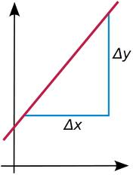
Slope
Slope: A number that shows how much the line tilts or its steepness.
Often referred to as RISE OVER RUN.
Slope (m) is determined by calculating the change in (Δ) two y values divided by the change in (Δ) two x values.
y₂ – y₁ = Δy = rise x₂ – x₁ Δx run

Slide 41
Slope
Follow along as I walk through this example.
Example 1: What is the slope of a line that passes through (2, -5) and (6, -2)?
*Remember*: slope is the Δy divided by the Δx.
y₂ – y₁ = (-2 - ⁻5) = 3 = 0.75
x₂ – x₁ (6 – 2) 4
It doesn’t matter if you do y₂ – y₁ or y₁ – y_{2,} just as long as you use the same order of x coordinates.
Look at this to understand:
y₁ – y₂ = (-5 - ⁻2) = -3 = 0.75
x₁ – x₂ (2 – 6) -4

Slide 42
Slope
Follow along as I walk through this example.
Example 2 : The table shows the coordinates of three points contained in the graph of a line. What is the slope of the line?
x | y
-1 | 1
0 | 3
1 | 5

Slide 43
Slope
Follow along as I walk through this one.
Example 3 : What is the slope of the line that passes through the points (6, 13) and (10, 21)?

Slide 44
Slope
Follow along as I walk through this one.
Example 4 : What is the slope of the line that passes through (-4, 2) and (6, -4)?

Slide 45
Slope
Work on this one with your partner.
Example 5 : What is the slope of a line that passes through (-4, 2) and (0, 0)?

Slide 46
Slope
Work on this one with your partner.
Example 6 : What is the slope of a line that passes through (7, 5) and (1, 3)?

Slide 47
Slope
Work on this one with your partner.
Example 7 : The table shows the coordinates of three points contained in the graph of a line. What is the slope of the line?
x | y
-6 | -4
0 | -2
6 | 0

Slide 48
Slope
Work on this one with your partner.
Example 8 : The table shows the coordinates of three points contained in the graph of a line. What is the slope of the line?
x | y
7 | 8
10 | 9
13 | 15

Slide 49
Slope
Work on this one on your own.
Example 9 : The table shows the coordinates of three points contained in the graph of a line. What is the slope of the line?
x | y
5 | -4
9 | 7
14 | -12

Slide 50
Slope
Example 10: Work on this one one your own.
What is the slope of the line that passes through the points (8, 15) and (8, 19)?

Slide 51
Slope
Work on this one on your own.
Example 11 : The table shows the coordinates of three points contained in the graph of a line. What is the slope of the line?
x | y
7 | 10
2 | 9
1 | 6

Slide 52
Slope
Example 12: Work on this one one your own.
What is the slope of the line that passes through the points (10, 6) and (7, 4)?

Slide 53
Exit Ticket
Each of you will complete your exit ticket on a note card.
You will complete the exit ticket in 5 minutes and it must be turned in before you can exit the classroom.
You must work SILENTLY and INDEPENDENTLY.
HOMEWORK – Worksheet

Slide 54
Do Now – ( 22/22), (30/2), (60/5)
Please respond to the following SILENTLY & INDEPENDENTLY:
What is the slope of a line that passes through the points (3,12), and (10, 2)?
What is the slope of the line with the points given in the table?
x | y
12 | 7
14 | 5
15 | -3

Slide 55
Today’s Objective
SWBAT determine the slope from a graph.

Slide 56
Determining Slope from a Graph
In order to determine the slope of a graph, you must determine what the rise is and put it over whatever the run is.
Pick 2 points on the graph.
Pick points where the line is on the intersection of the coordinate plane.
Determine the rise by going up on the graph until you reach the level of your next point.
THIS IS YOUR CHANGE IN Y, or your rise.
Determine the run by going left or right on the graph until you reach the next point.
THIS IS YOUR CHANGE IN X, or your run.
Put your rise over your run and that is your slope.
We’ll go over this on the next slide.

Slide 57
Determining Slope from a Graph
Watch as I walk through this example.
Example 1 : Determine the slope of the line graphed below.

Slide 58
Determining Slope from a Graph
Walk as I walk through this example.
Example 2 : Determine the slope of the line graphed below.

Slide 59
Determining Slope from a Graph
Walk as I walk through this example.
Example 3 : Determine the slope of the line graphed below.

Slide 60
Determining Slope from a Graph
Work on this one WITH YOUR PARTNER QUIETLY.
Example 4 : Determine the slope of the line graphed below.

Slide 61
Determining Slope from a Graph
Work on this one WITH YOUR PARTNER QUIETLY.
Example 5 : Determine the slope of the line graphed below.

Slide 62
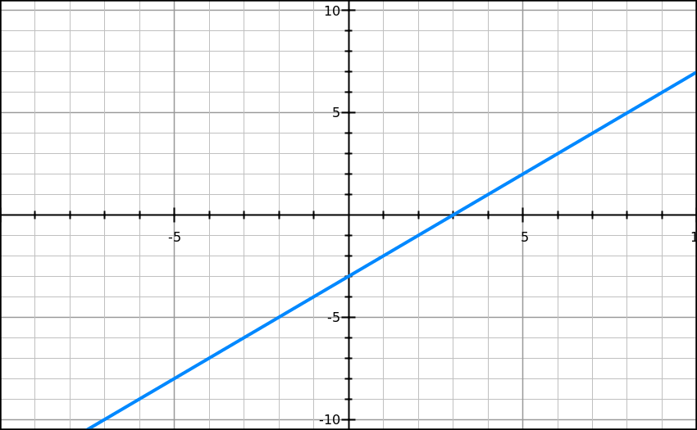
Determining Slope from a Graph
Work on this one WITH YOUR PARTNER QUIETLY.
Example 6 : Determine the slope of the line graphed below.

Slide 63
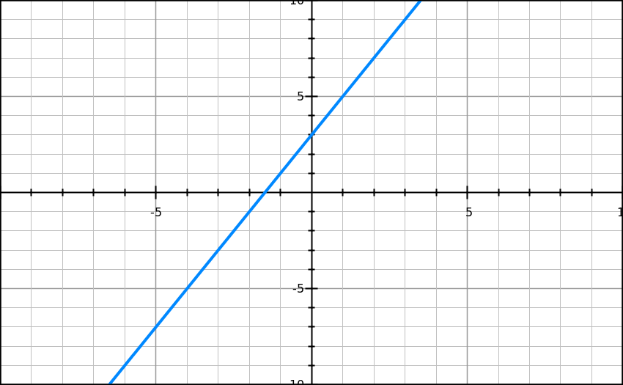
Determining Slope from a Graph
Work on this one WITH YOUR PARTNER QUIETLY.
Example 7 : Determine the slope of the line graphed below.

Slide 64
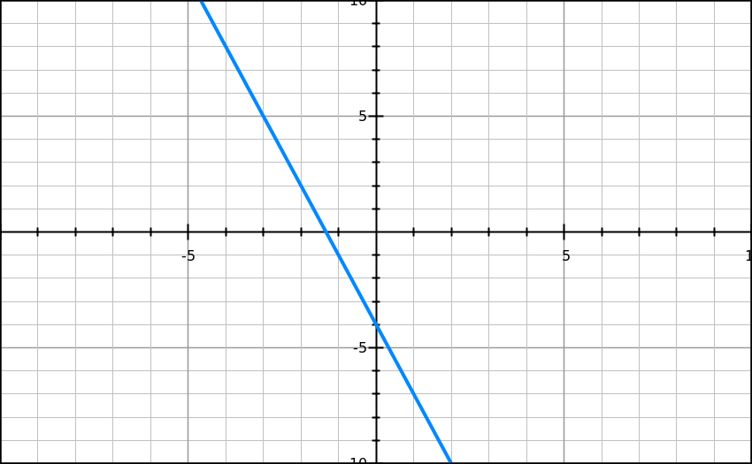
Determining Slope from a Graph
Work on this one ON YOUR OWN SILENTLY.
Example 8 : Determine the slope of the line graphed below.

Slide 65
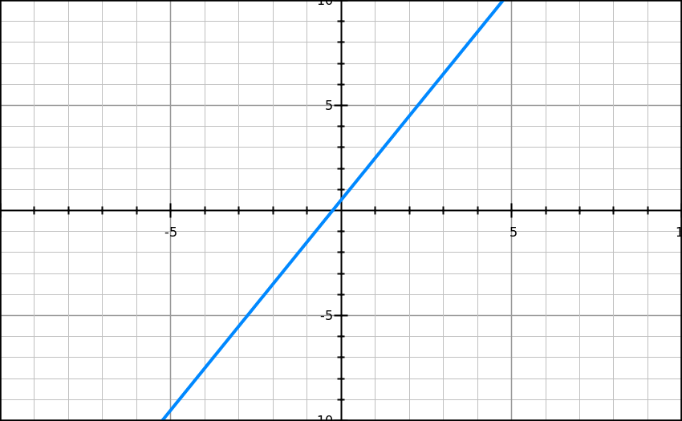
Determining Slope from a Graph
Work on this one ON YOUR OWN SILENTLY.
Example 9 : Determine the slope of the line graphed below.

Slide 66
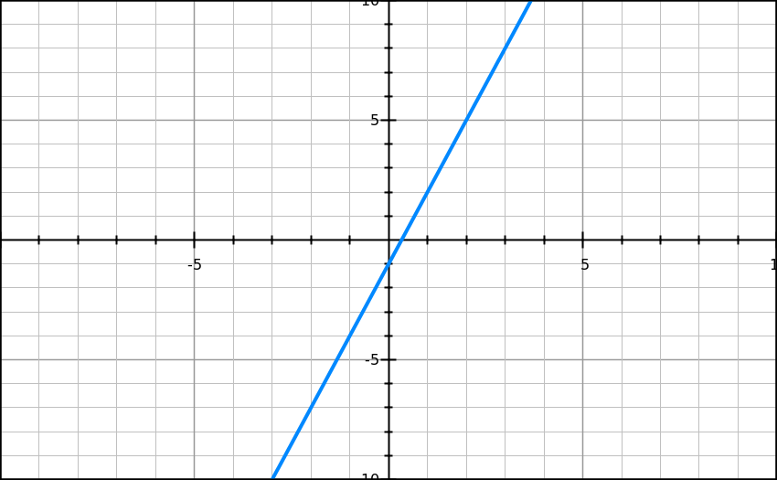
Determining Slope from a Graph
Work on this one ON YOUR OWN SILENTLY.
Example 10 : Determine the slope of the line graphed below.

Slide 67
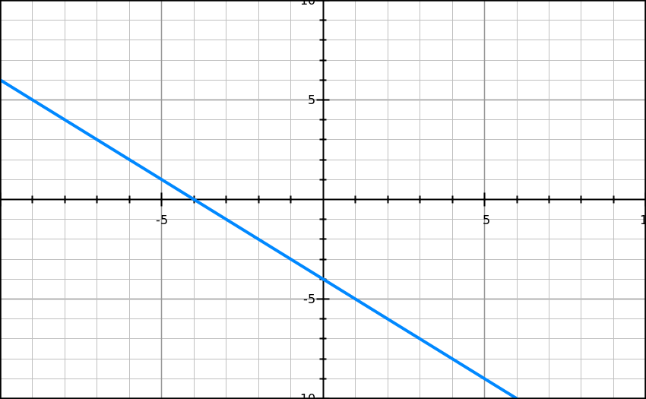
Determining Slope from a Graph
Work on this one ON YOUR OWN SILENTLY.
Example 11 : Determine the slope of the line graphed below.

Slide 68
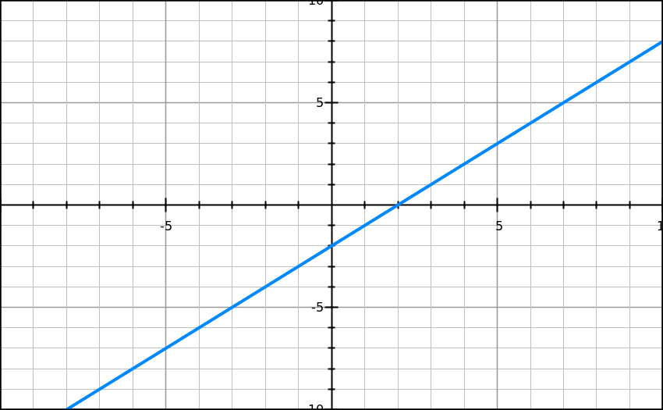
Determining Slope from a Graph
Work on this one ON YOUR OWN SILENTLY.
Example 12 : Determine the slope of the line graphed below.

Slide 69
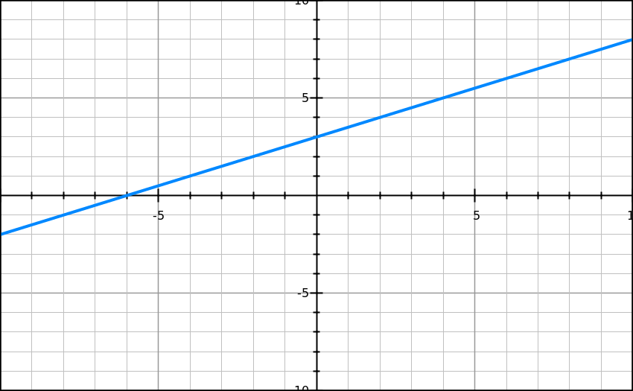
Determining Slope from a Graph
Work on this one ON YOUR OWN SILENTLY.
Example 13 : Determine the slope of the line graphed below.

Slide 70
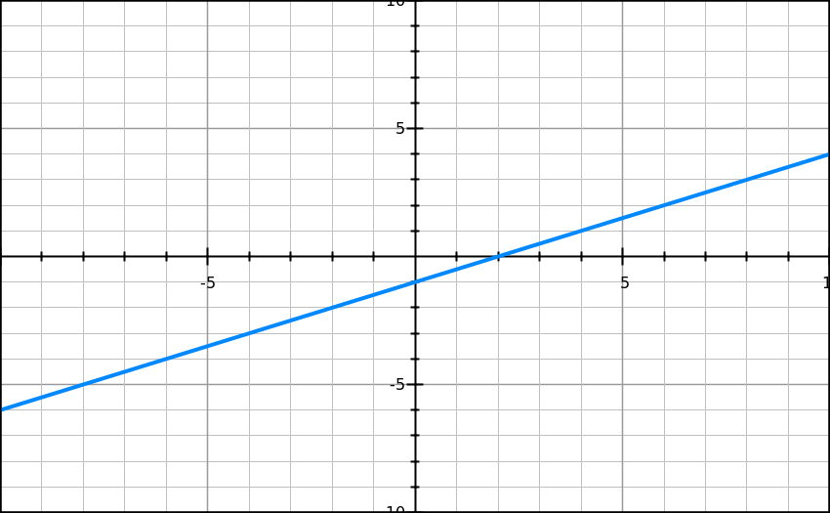
Determining Slope from a Graph
Work on this one ON YOUR OWN SILENTLY.
Example 14 : Determine the slope of the line graphed below.

Slide 71
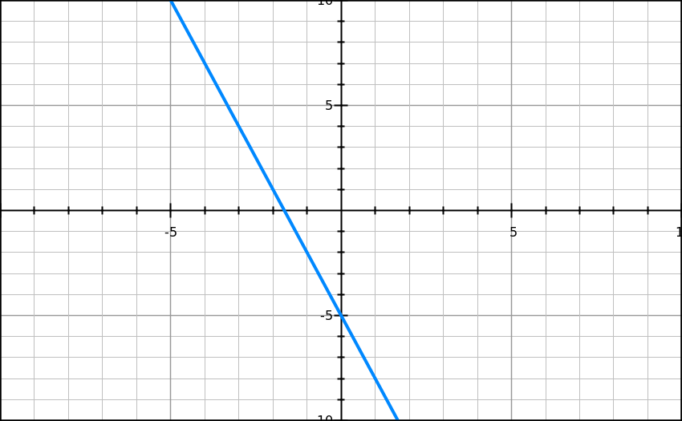
Determining Slope from a Graph
Work on this one ON YOUR OWN SILENTLY.
Example 15 : Determine the slope of the line graphed below.

Slide 72
Slope
Work on this one ON YOUR OWN SILENTLY.
Example 16: What is the slope of a line that passes through (-10, 5), (20, 10)?

Slide 73
Slope
Work on this one ON YOUR OWN SILENTLY.
Example 17: What is the slope of the line given the table?
x | y
5 | 12
7 | 15
9 | 20

Slide 74
Exit Ticket
Each of you will complete your exit ticket on a note card.
You will complete the exit ticket in 5 minutes and it must be turned in before you can exit the classroom.
You must work SILENTLY and INDEPENDENTLY.
HOMEWORK – Worksheet

Slide 75
Do Now – ( 55/5), (4²), (24/2)
Please clear off your desk of everything except a pencil, calculator, and a plain sheet of paper (to cover your quiz with).
The longer it takes you to complete this, the less time you will have for your quiz.

