Slide 2
Do Now -- √121, (20-1), (6 x 2)
Please pick up your guided notes and respond to the following SILENTLY & INDEPENDENTLY:
Write BOTH formulas for slope.
Find the slope of a line that passes through (-10, 8) and (15, 7) .
What is the slope of the given graph?

Slide 3
Weekly Agenda
Monday – Slope-Intercept Form & Writing Equations
Tuesday – Slope Intercept Form

Slide 4
Today’s Objective
SWBAT create an equation from a graph by identifying the y-intercept and slope.

Slide 5
Brain POP!
Brain POP!

Slide 6
Slope Intercept Form
Each function has an equation that corresponds to it.
If the equation is in the correct form, it can indicate a lot about the line.
The correct form for an equation of a line is called slope intercept form.
Written as y = mx + b
Where m = slope
Rise over run
Where b = y –intercept
The point on the graph where the line crosses the y- axis.
x and y refer to coordinates that fall on the line.

Slide 7
Slope – Intercept Form
Example 1: Identify the slope and y –intercept.
y = 3x - 7

Slide 8
Slope – Intercept Form
Example 2: Identify the slope and y –intercept.
y = ½ x + 2

Slide 9
Slope – Intercept Form
Example 3: Identify the slope and y –intercept.
y = 4 x - 5

Slide 10
Slope – Intercept Form
Example 4: Identify the slope and y –intercept.
y = ¾x - 1

Slide 11
Slope – Intercept Form
Example 5: Identify the slope and y –intercept.
y = -5x + 2

Slide 12
Slope – Intercept Form
Example 6: Identify the slope and y –intercept.
y = -9x + 10

Slide 13
Slope – Intercept Form
Example 7: Identify the slope and y –intercept.
y = -7x + 4

Slide 14
Writing an Equation from a Graph
The following steps will help you write an equation from a graph:
Step 1: Identify the y-intercept.
Step 2: Identify the slope.
Step 3: Sub the y-intercept and slope into the slope intercept form equation (y = mx + b).

Slide 15
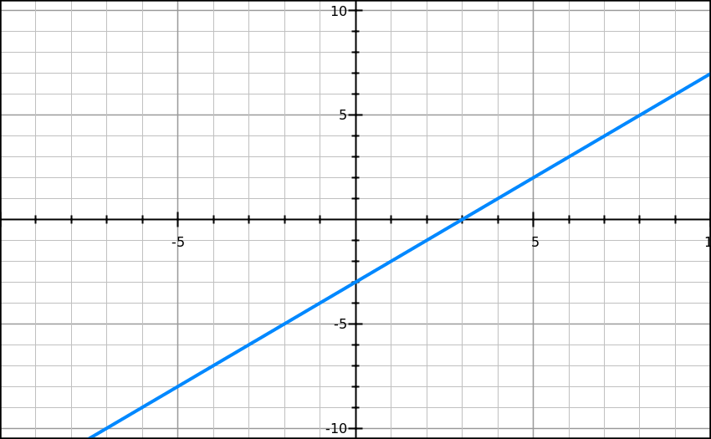
Example 8- Follow along with me.
Step 1: Identify the y-intercept.
Step 2: Identify the slope.
Step 3: Sub the y-intercept and slope into the slope intercept form equation
(y = mx + b).
Answer:

Slide 16
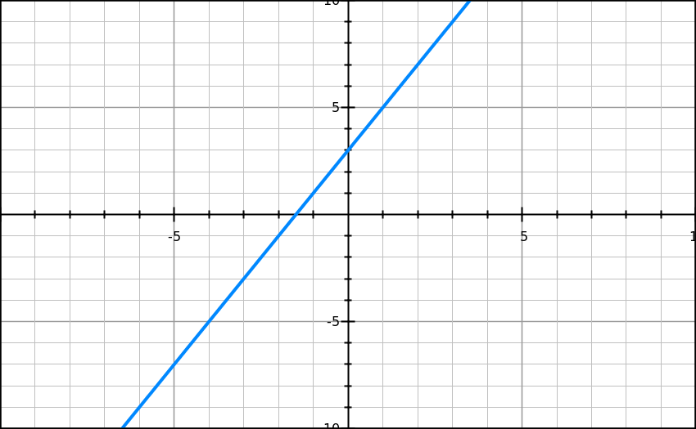
Example 9 – Follow along with me.
Step 1: Identify the y-intercept.
Step 2: Identify the slope.
Step 3: Sub the y-intercept and slope into the slope intercept form equation
(y = mx + b).
Answer:

Slide 17
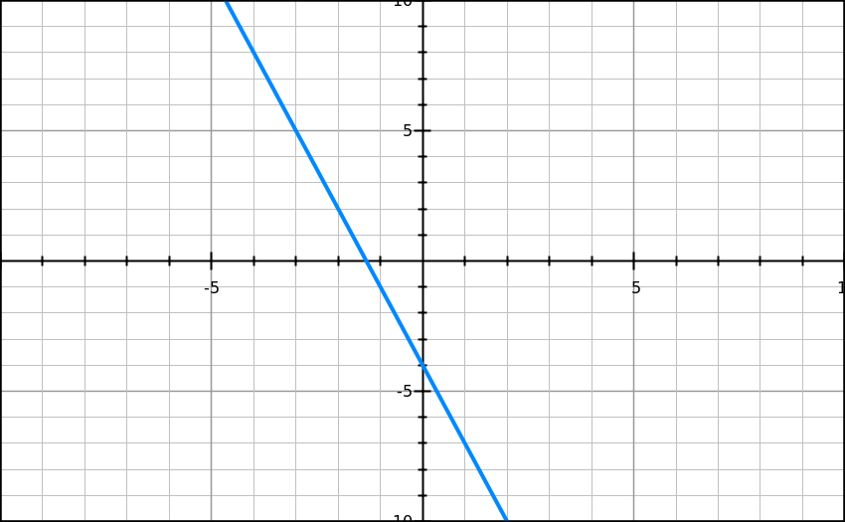
Example 10 – Follow along with me.
Step 1: Identify the y-intercept.
Step 2: Identify the slope.
Step 3: Sub the y-intercept and slope into the slope intercept form equation
(y = mx + b).
Answer:

Slide 18
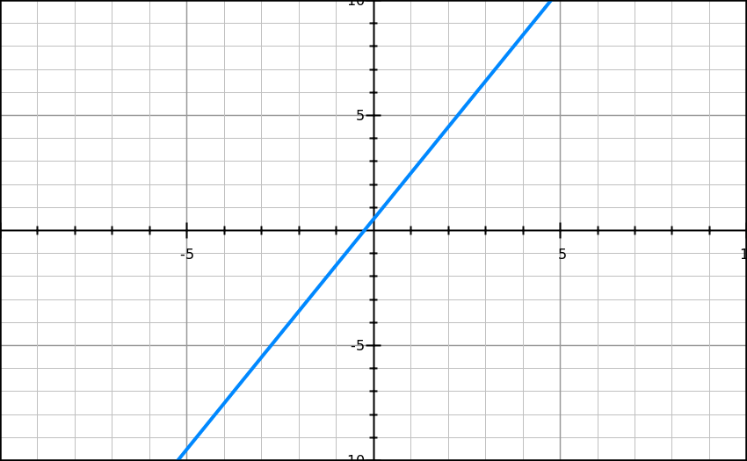
Example 11 – Work on this with your partner.
Answer:

Slide 19
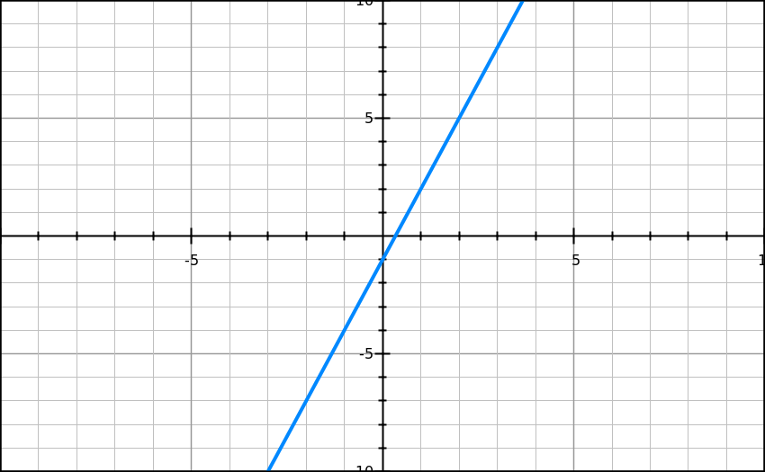
Example12 – Work on this with your partner.
Answer:

Slide 20
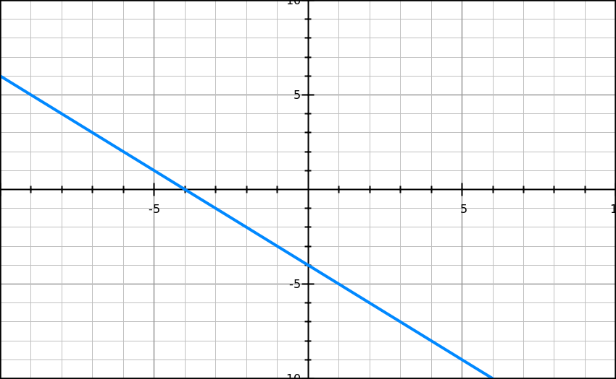
Example 13 – Work on this with your partner.
Answer:

Slide 21
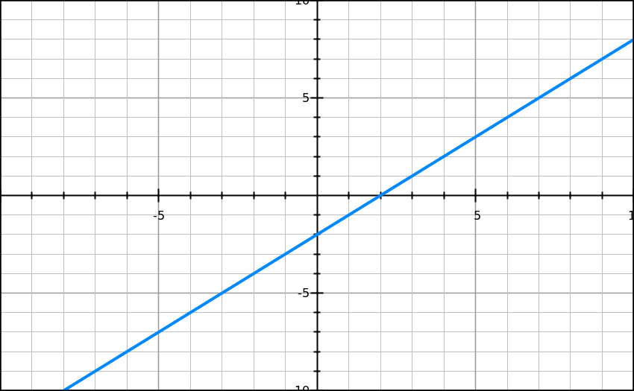
Example 14 – Work on this on your own.
Answer:

Slide 22
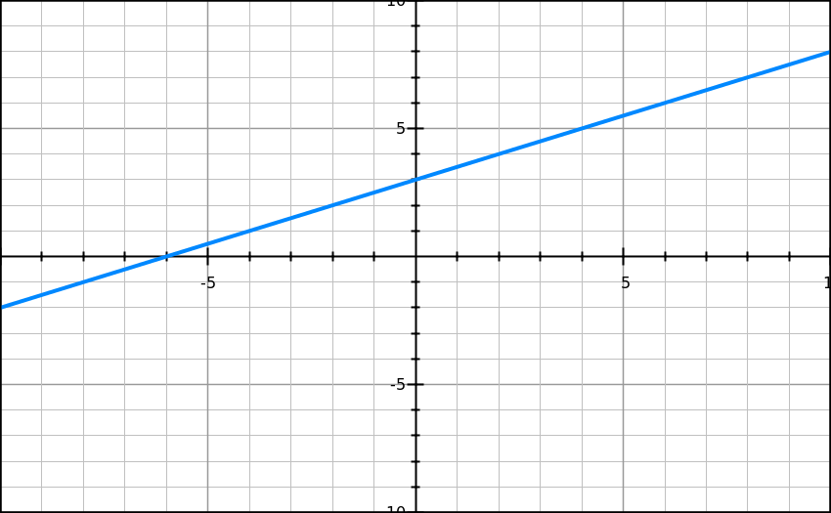
Example 15 – Work on this on your own.
Answer:

Slide 23
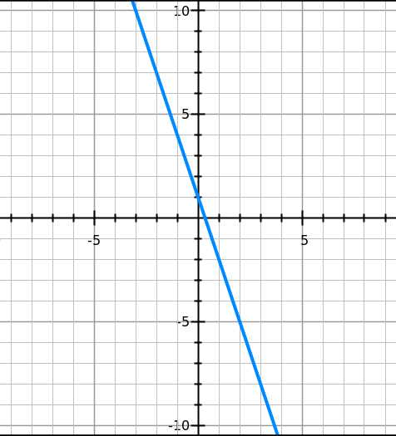
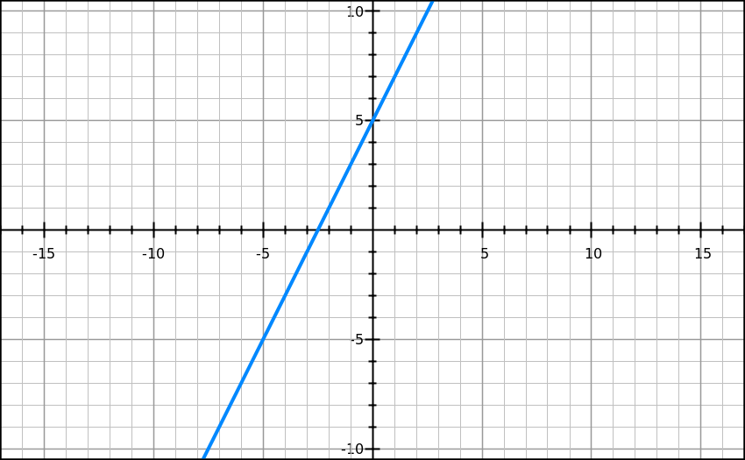
Exit Ticket
Respond to the following SILENTLY & INDEPENDENTLY:
2.
1.

Slide 24
Do Now – √121, (10 x 2)
Please take out your notes and respond to the following SILENTLY & INDEPENDENTLY:
Identify the slope and y-intercept of y = ¾ x – 6
Identify the slope and y-intercept and write the equation of the line in slope intercept form for the graph to the right.

Slide 25
Today’s Objective
SWBAT write and equation given a graph.

Slide 26
Writing an Equation from a Graph
The following steps will help you write an equation from a graph:
Step 1: Identify the y-intercept.
Step 2: Identify the slope.
Step 3: Sub the y-intercept and slope into the slope intercept form equation (y = mx + b).

Slide 27
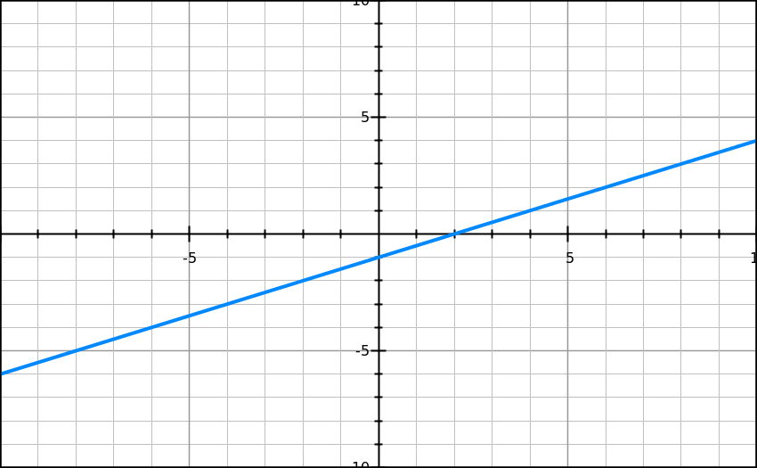
Example 1 – Watch as I walk through this one.
Answer:

Slide 28
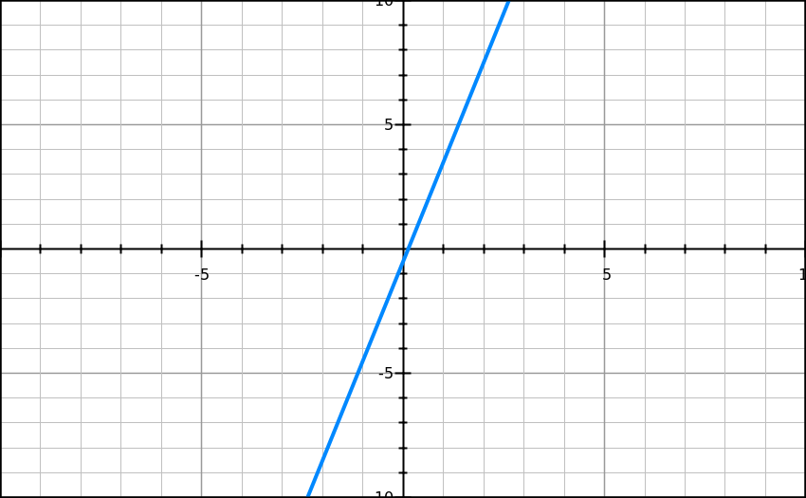
Example 2 – Walk me through this one.
Answer:

Slide 29
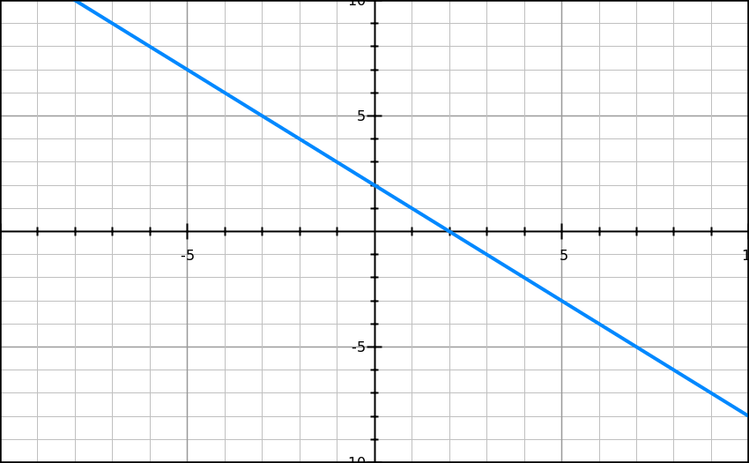
Example 3 – Walk me through this one.
Answer:

Slide 30
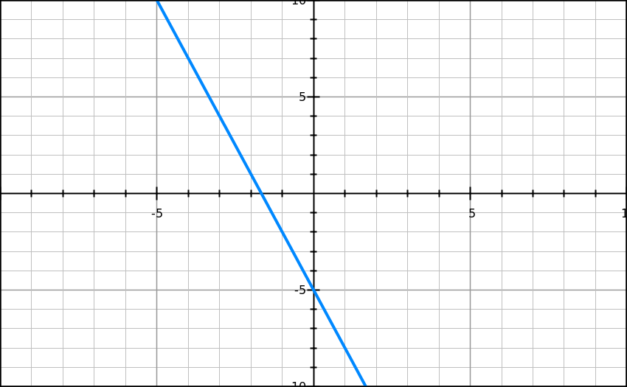
Example 4 – Work on this one with your partner.
Answer:

Slide 31
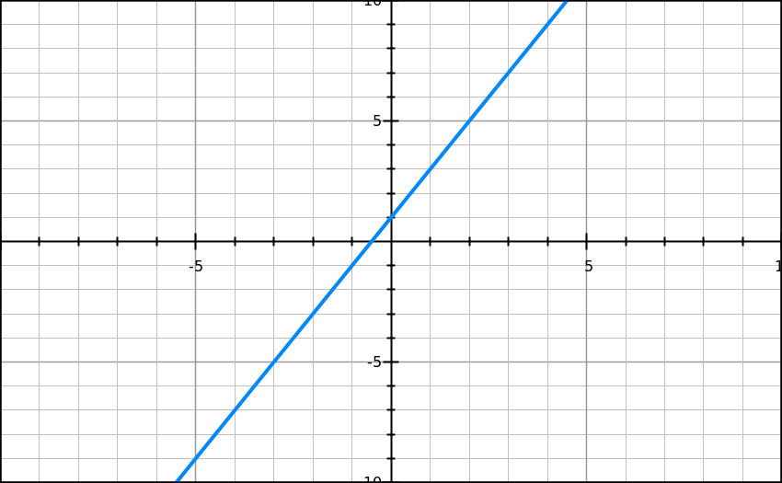
Example 5 – Work on this one with your partner.
Answer:

Slide 32
Example 6 – Work on this one with your partner.
Answer:

Slide 33
Example 7 – Work on this on your own.
Answer:

Slide 34
Example 8 – Work on this on your own.
Answer:

Slide 35
Example 9 – Work on this on your own.
Answer:

Slide 36
Example 10 – Work on this on your own.
Answer:

Slide 37
Example 11 – Work on this on your own.
Answer:

Slide 38
Example 12 – Work on this on your own.
Answer:

