Slide 1
Do Now – (√4), (√16), (√169)
Please take out a piece of paper and respond to the following SILENTLY:
Which function is nonlinear?
  f(x) = -7
  f(x) = 2x + 4
  f(x) = x2
  f(x) = -3x -5
What is the slope of the line containing (-4,2) and (0,-10)?
Which of the following numbers is rational?
a) π b)√8 c)√9 d)√10

Slide 2
Weekly Agenda
Monday – Review last week’s quiz
Tuesday/Wednesday – Retake last week’s quiz/ misleading data
Thursday – Misleading data
Friday – Quiz

Slide 3
Today’s Objective
SWBAT re-work last week’s quiz to review scatter plots and best fit lines.

Slide 4
Do Now – (√81 - √49), (36/6), (20 – 7)
Please pick up your new guided notes.
Please clear off your desk of everything except your pencil, your calculator, and a plain sheet of paper (to cover your quiz with).
Wait SILENTLY for further instruction.
The longer it takes you to do this, the less time you will have for your quiz.

Slide 5
Do Now – (-5 + 7), (⅝ x 8), (-10 + 23)
Pleas pick up your guided notes and respond to the following SILENTLY & INDEPENDENTLY:
Ms. Misconish wants to drive from Gatlinburg to Nashville, a distance of about 222 miles. Her car gets its best gas mileage when she drives at 55 mph. At that rate, how long will it take her to get form Gatlinburg to Nashville?
If f(x) = x/3 and g(x) = (2x-1)/4, what is the value of x when f(x) = g(x)?

Slide 6

Student of the Week
Mario was chosen as student of the week because…
  Has improved his quiz scores from high C’s/B’s to high A’s!
  Is very well behaved in class!
  Participates when no one else wants to!
  Asks questions to clear up confusion!
  Very kind, helpful, and respectful!
Mario Washington

Slide 7
Today’s Objective
SWBAT re-master scatter plots and best fit lines.
SWBAT identify appropriate data displays and explain how a graph has been intended to mislead and how it should be changed to better represent the data.

Slide 8
Misleading Data
Statistics are often used to mislead people by presenting the information with the wrong display or manipulating the scale used to represent the results on the graph.
  The wrong display can present the data incorrectly to make you think something untrue.
  Scales can be manipulated to exaggerate or minimize differences in the data displayed on the graph.
  A graph may be misleading because its scale is broken or numbers are left off of the scale.
  A graph may be misleading if the graph’s intervals are not equal.
  Using samples that are not representative of a population.
A graph is misleading if it is set up to minimize important relationships or exaggerate unimportant ones.

Slide 9
Misleading Data
Depending on the data, a specific type of display is necessary. Below is a table of appropriate data displays.
Type of Display | Best Used to…
Bar Graph | Show the number of items in specific categories
Box and Whisker Plot | Show measures of variation for a set of data
Circle Graph | Compare parts of the data to the whole
Double Bar Graph | Compare two sets of categorical data
Double Line Graph | Compare change over time for two sets of data
Histogram | Show frequency of data divided into equal intervals
Line Graph | Show change over time
Line Plot | Show how many times each number occurs
Scatter Plot | Show relationship between a data set with two variables
Stem and Leaf Plot | List all individual numerical data in condensed form

Slide 10
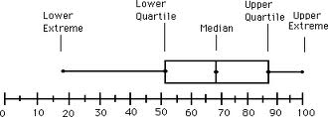
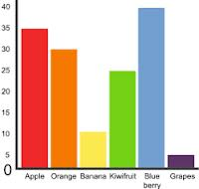
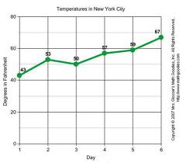
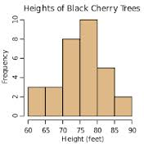
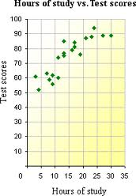
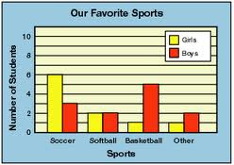
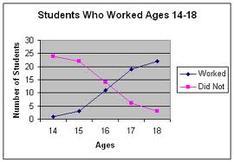
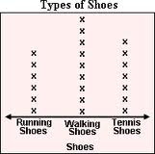
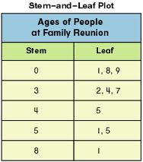
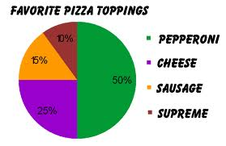
Misleading Data
Box and Whisker Plot
Bar Graph
Line Graph
Histogram
Scatter Plot
Double Bar Graph
Double Line Graph
Line Plot
Circle Graph
Stem and Leaf Plot

Slide 11
Misleading Data
How to Determine if a Graph is Misleading:
  Read and annotate the graph for the following features:
    Title (underline)
    Labels on the X and Y axes (circle)
    Use the scale/key to label each individual data point on the graph
  Closely examine the scale – check that it:
    Begins at zero
    Increases at a steady rate
    Has intervals that are equally spaced
  Read the question carefully and answer it

Slide 12
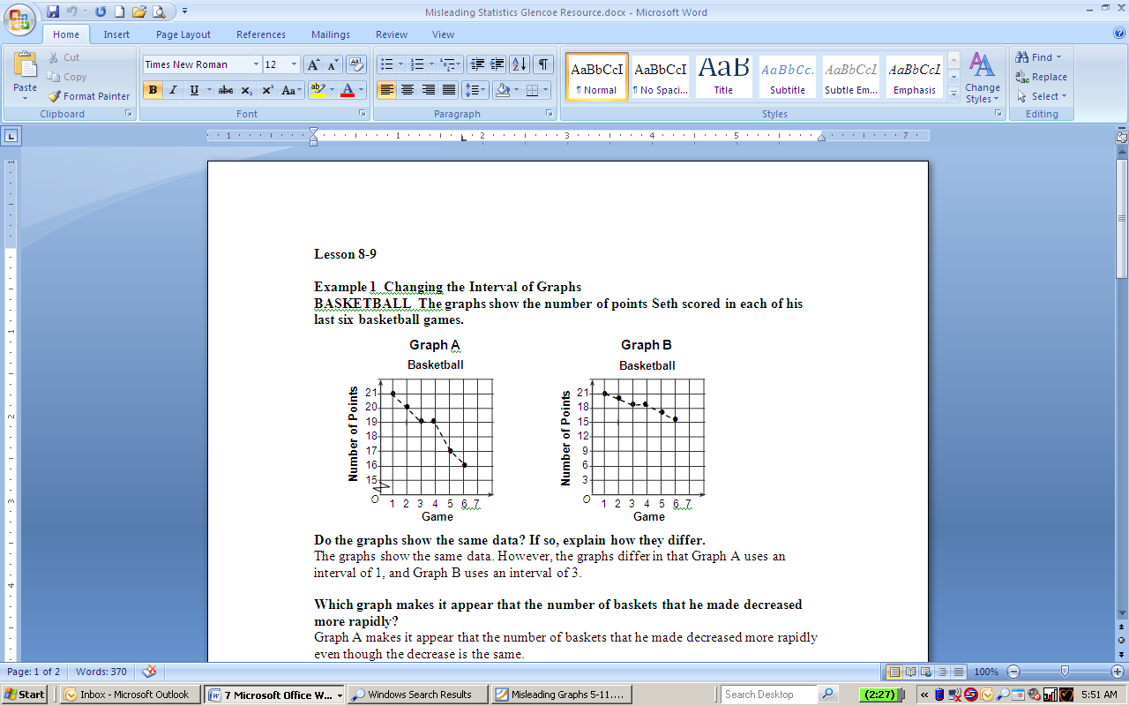
Misleading Data
Example 1: Do these graphs show the same data? If so, how do they differ?
Turn and Talk: Which graph would you use to convince your parent you needed to go to summer basketball camp to work on your shot? Why?

Slide 13
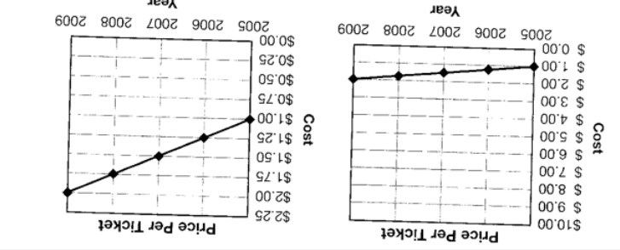
Misleading Data
Example 2: Do these graphs show the same data? If so, how do they differ?
Turn and Talk: Which graph would you use to convince someone that the price has increased dramatically over the years of 2005 - 2009? Why?

Slide 14
Misleading Data
Example 3: Do these graphs show the same data? If so, how do they differ?
Turn and Talk: Which graph would be used to best convince someone that Jules is the obvious winner of the class election? Why?

Slide 15
Misleading Data
Example 4: Do these graphs show the same data? If so, how do they differ?
Turn and Talk: Which graph would you use to convince someone that the unemployment rate has changed greatly from year to year? Why?

Slide 16
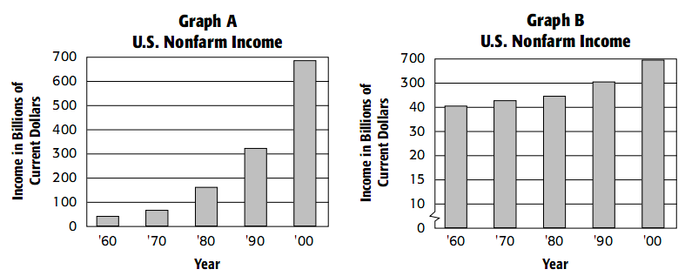
Misleading Data
Example 5: Do these graphs show the same data? If so, how do they differ?
Turn and Talk: Which graph would you use to convince someone that the nonfarm income has minimally changed from 1960 - 2000? Why?

Slide 17
Misleading Data
Example 6: Do these graphs show the same data? If so, how do they differ?
Turn and Talk: Which graph would you use to convince someone that 3 times as much pizza is sold as tacos? Why?

Slide 18
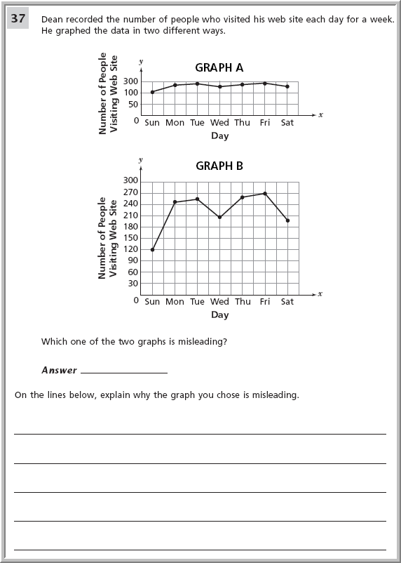
Misleading Data
Example 7: Do these graphs show the same data? If so, how do they differ?
Turn and Talk: Which graph would you use to convince someone that the amount of visitors hasn’t really changed over time? Why?

Slide 19
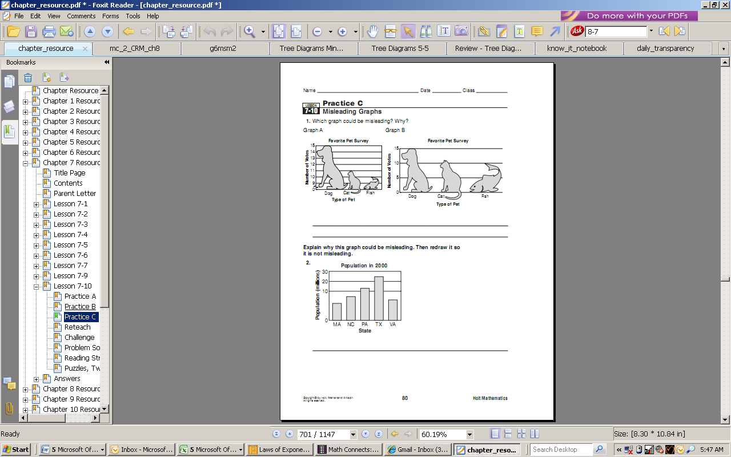
Misleading Data
Example 8: Do these graphs show the same data? If so, how do they differ?
Turn and Talk: Which graph would you use to convince someone that the favorite pet is obviously a dog? Why?

Slide 20
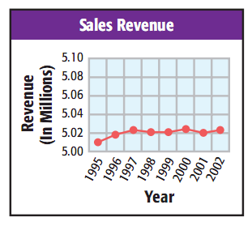
Misleading Data
Example 9:Which of the following statements could be true about the graph below?
  The sales trend increased significantly from 1995-2002.
  The graph is misleading
  because the scale begins at
  5.
  The graph is misleading
  because the intervals
  increase by two
  hundredths, exaggerating
  the differences in the data
  points.
  Both B and C.

Slide 21
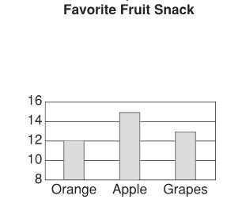
Misleading Data
Example 10:How could the graph be redrawn to better represent the data?
  The scale should be redrawn to have intervals of 10.
  The bars should touch.
  The scale should be redrawn to have intervals of 2.
  This data should be represented in a circle graph.

Slide 22
Do Now – (¼ x 8), (√49), (⅞ x 8 + 6)
Solve.
Explain the location of the numbers -1.8 and -1.88 relative to each other and other whole numbers on the number line.

Slide 23
Today’s Objective
SWBAT identify why data is misleading.

Slide 24
Misleading Data
Example 1: The bar graph shows the heights of the tallest buildings in Nashville. Kay said that the BellSouth Tower is at least 10 times as tall as City Center. Is she incorrect?

Slide 25
Misleading Data
Example 2: The tables below show the prices of 6 homes in January and November. A newspaper reported $160,000 is the average price of homes and has remained that amount from January through November. How is the report misleading?

Slide 26
Misleading Data
Example 3: A number of polls were taken after a debate between Obama and Romney. One poll showed that Obama was declared the winner 75% to 25%. A second poll showed that Romney was declared the winner 85% to 15%. Four other polls showed that Obama was declared the winner 60% to 40%. Which poll or polls are most likely accurate? Who won the debate?

Slide 27
Misleading Data
Example 4: The circle graph shows how people in a town feel about their mayor. A radio station that supports the mayor said that the mayor has an approval rating of about 60%. Why is this misleading?

Slide 28
Misleading Data
Example 5: A doctor’s office put an ad in the newspaper for a receptionist. Including the doctor, the office has 5 employees. The salaries of the employees, including the doctor, are $25,000; $20,000; $400,000; $35,000; and $20,000. The ad said that the average salary was $100,000. Is this ad misleading? Why or why not?

Slide 29
Misleading Data
Example 6: A radio station’s poll showed that 85% of its listeners would like fewer commercials during rush hour. Three other polls not conducted by the radio station showed that only 45% of the people would like fewer commercials during rush hour. What is most likely the cause of the discrepancy between the radio station’s poll and the other polls?

Slide 30
Misleading Data
Example 7: ATT wants to know which cell phone company most people in Memphis prefer. ATT calls 100 Memphis residents who have ATT and learn that 80% of customers prefer ATT. Then ATT calls 100 people at random from the phone book and learns that 40% of the people prefer ATT. Which sample is more accurate?

Slide 31
Misleading Data
Example 8: A politician wants to know what voters think about pay raises. She asks every person at her fundraiser. She finds that 98 out of 100 people at the fundraiser approve of pay raises. Which of these statements is true about the sample?
  The sample is biased because it includes only people who tend to agree with her views.
  The sample is biased because it includes only people who want a free lunch.
  The sample is random and shows that she truly represents what the voters think about the pay raises.
  The sample is random because 100 people were chosen at the same time.

Slide 32
Misleading Data
Example 9: A magazine has published a table with 2008-2009 financial aid profile for the University of Tennessee. Which of the following conclusions shows how the information in this table may be misleading?
  The table does not show the number of students who did not apply for financial aid.
  The table does not show how many applicants were found to have financial need.
  The table does not show
  whether students are
  freshman or not.
  The table does not compare
  its statistics to other years.

Slide 33
Misleading Data
Example 10: In a survey, students were asked if they would like to have longer school days if they could have a longer summer vacation. 85% of the students surveyed said ‘yes’ while 15% surveyed said ‘no’. The question and circle graph are the results of the survey. What is misleading about these results?
  The graph does not show who is
  being surveyed.
  The segments of the graph aren't
  drawn to scale.
  The question only addresses part
  of the topic.
  The question is not objective

Slide 34
Misleading Data
Example 11: The table shows the lunch choices of students for one day. The data was then represented in a circle graph. What is misleading about the graph?
  The title is confusing.
  The scale is wrong.
  The section labels are wrong.
  The sections are the wrong sizes.

Slide 35
Misleading Data
Example 12: The bar graph shows the results of a survey on the favorite type of pet among eighth graders. Which of the following best explains why the graph might be considered misleading?
  The title is misleading.
  The vertical axis doesn’t begin at 0.
  The horizontal axis should include
  more types of pets.
  The scale on the vertical axis is too
  large.

Slide 36
Misleading Data
Example 13: Patti took a poll of all the students in the cafeteria and created the following circle graph from the data. Patti said that about 60% of students do not like pizza. Why is Patti incorrect?
  The graph says that about 40% of
  students do not like pizza.
  Since most students who like pizza
  also like fried chicken and hotdogs,
  Patti should have said that about
  25% of students do not like pizza.
  Since the cafeteria serves pizza only
  20% of the time, Patti should have
  said that only 20% of students like pizza.
  The graph shows only students’
  favorite lunches, not whether they
  do not like a particular food.

Slide 37
Misleading Data
Example 14:

Slide 38
Do Now – (√81 - √49), (⅕ x 40), (20 – 7)
Please clear off your desk of everything except your pencil, your calculator, and a plain sheet of paper (to cover your quiz with).
Wait SILENTLY for further instruction.
The longer it takes you to do this, the less time you will have for your quiz.

