Slide 2
Do Now - √121, (13 x 2), (10 + 2)
Please pick up your guided notes and respond to the following SILENTLY & INDEPENDENTLY:
Identify the slope and y –intercept of this equation: y = -½x + 7
Identify the slope and y –intercept of this equation: y = 4x
Identify the slope and y-intercept of the graph and then write an equation for the graph.

Slide 3
Weekly Agenda
Monday – Equations from Graphs & Graphs from Equations
Tuesday/Wednesday – Discovery Testing & Putting Equations in y = mx + b form
Thursday/ Friday – Review Worksheets - substitute

Slide 4
Today’s Objective
SWBAT match an equation with the given graph.
SWBAT graph an equation.

Slide 5
Equations & Graphs
Last week, we wrote equations from different graphs.
Today, we will be given a graph and multiple equations and will need to determine which equation matches the graph.
Afterward, we will be given an equation and will create the corresponding graph.

Slide 6
Identifying the Equation of a Graph
To determine which equation matches the graph there are a few steps to follow:
Identify the y –intercept of the graph.
Eliminate answer choices based on the y-intercept.
Identify the slope of the graph.
Eliminate answer choices based on the slope.
Check the final answer with the graph.

Slide 7
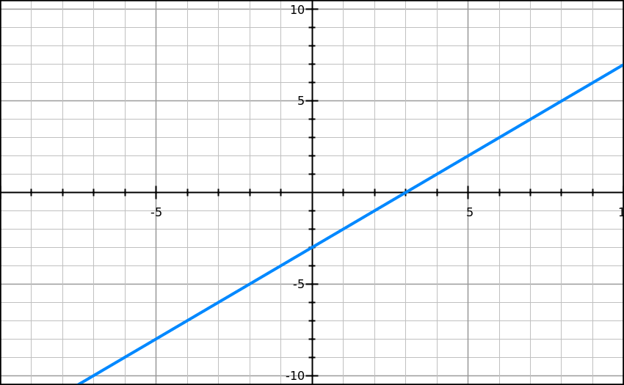
Example 1
Which linear equation is best represented by this graph?
Follow along as I walk through this one.
a) y = x + 2 c) y = x - 3
b) y = 2x -2 d) y = 3x - 1

Slide 8
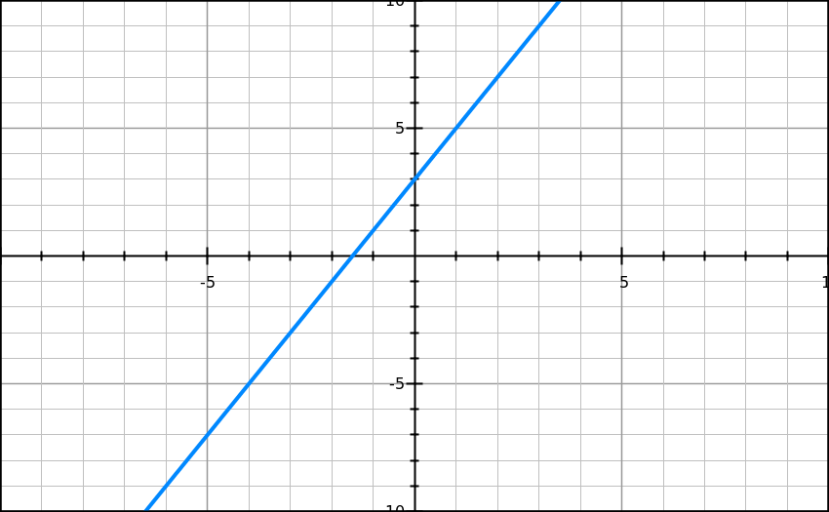
Example 2
Which linear equation is best represented by this graph?
Follow along as I walk through this one.
a) y = 2x +3 c) y = x + 3
b) y = 2x – 3 d) y = x - 3

Slide 9
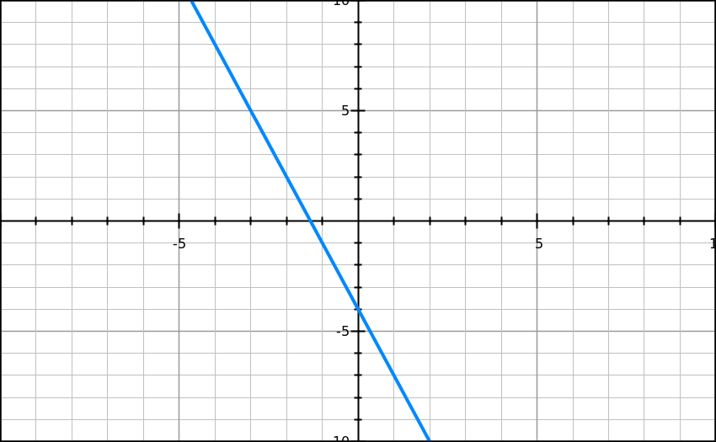
Example 3
Which linear equation is best represented by this graph?
Follow along as I walk through this one.
a) y = 3x – 4 c) y = 3x + 4
b) y = -3x – 4 d) y = -3x + 4
Notes:
Stopped with 8-3

Slide 10
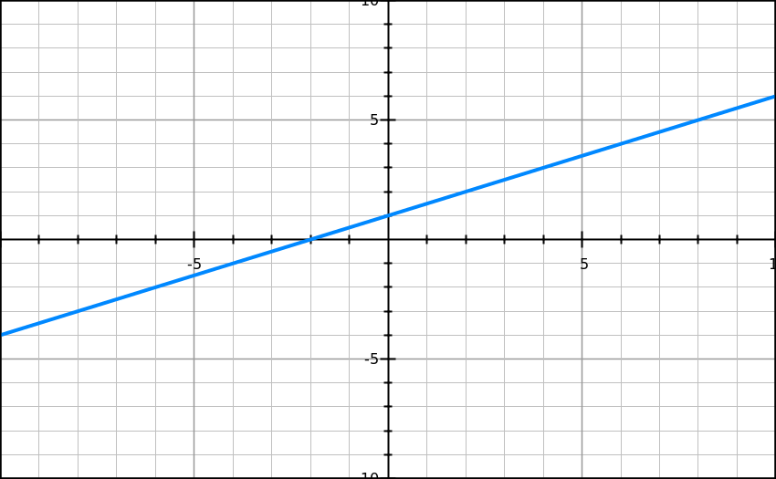
Example 4
Which linear equation best represents the graph?
Walk me through this one.
y = x + 1
y = ½x – 1
y = ½x + 1
y = x - 1

Slide 11
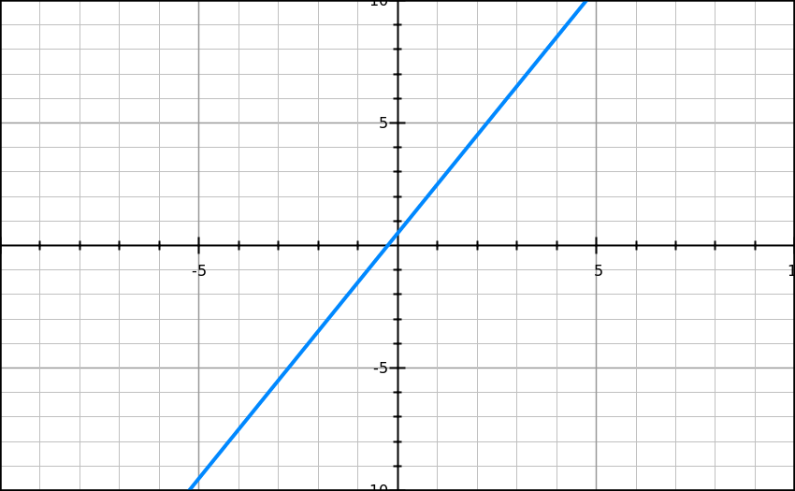
Example 5
Which linear equation best represents the graph?
Work on this one with your partner.
y = 2x + 1
y = x + ½
y = 2x + ½
y = x + 1

Slide 12
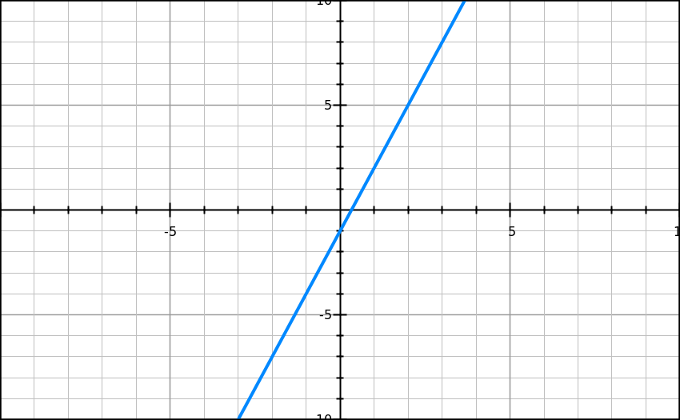
Example 6
Which linear equation best represents the graph?
Work on this one with your partner.
y = 3x - 1
y = -3x - 1
y = 3x + 1
y = -3x + 1

Slide 13
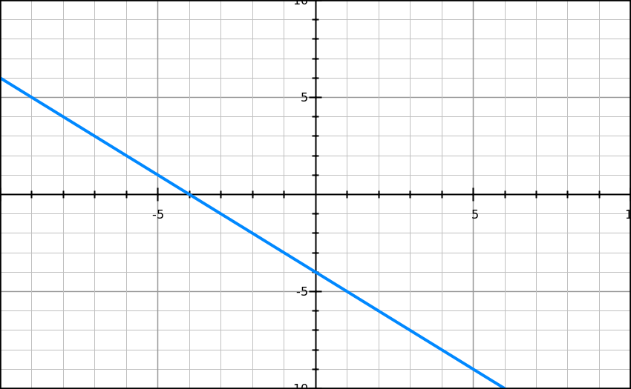
Example 7
Which linear equation best represents the graph?
Work on this one on your own.
y = x - 4
y = -x - 4
y = x + 4
y = -x + 4

Slide 14
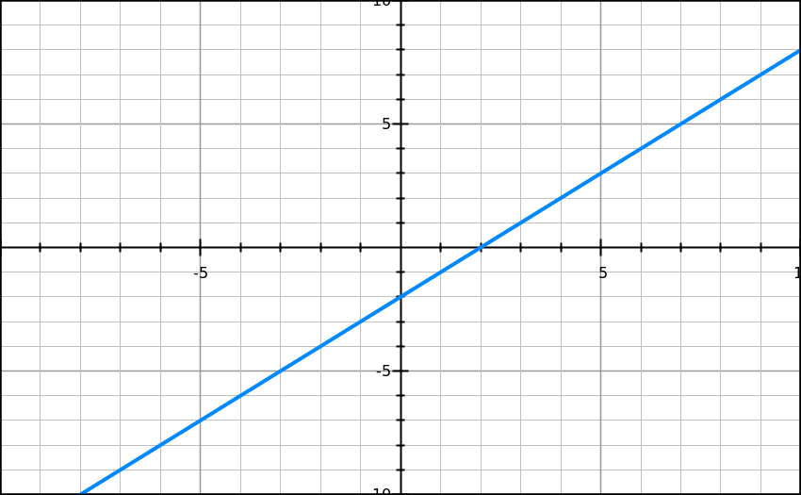
Example 8
Which linear equation best represents the graph?
Work on this one on your own.
y = x + 2
y = 2x - 1
y = 2x + 1
y = x - 2

Slide 15
Graphing Linear Equations
Now that we can match equations with graphs, we need to know how to match graphs with equations.
On the TCAP, you will see one equation and multiple graphs and have to determine which graph goes with the given equation.
Basically, we are reversing what we just did.

Slide 16
Graphing Linear Equations
In order to graph a linear equation, we need to follow a few steps and utilize the slope-intercept form equation.
Identify the y-int. of the equation.
Plot the y-int. on the y-axis (0, y-int.).
Identify the slope of the equation.
From the y-intercept, rise and run given the value of the slope.
Repeat step 4 a few times and connect the dots to finalize your graph.

Slide 17
Example 9
Plot y = -2x + ½
Follow along as I do this one.

Slide 18
Example 10
Plot y = 2x - 2
Follow along as I do this one.

Slide 19
Example 11
Plot y = -2x + 2
Work on this one with your partner.

Slide 20
Example 12
Plot y = 3x + 1
Work on this one with your partner.

Slide 21
Example 13
Plot y = ½x + 3
Work on this one with your partner.

Slide 22
Example 14
Plot y = 4x - 6
Work on this one on your own.

Slide 23
Example 15
Plot y = -¼x - 3
Work on this one on your own.

Slide 24
Exit Ticket
You will be given 4 minutes to complete the exit ticket.
You are not allowed to use your notes, your partner, or ask any questions.
Please put your name on your note card and answers ALL QUESTIONS completely.
After you are finished, flip the note card over.
Homework - Worksheet

Slide 25
Exit ticket
Which equation best represents this graph?
Y = 2x +10
Y = -½ x – 5
Y = ½x – 5
Y = ½x + 10
2. 2. Write an equation from the following graph and explain how you’d plot it.
HOMEWORK - Worksheet

Slide 26
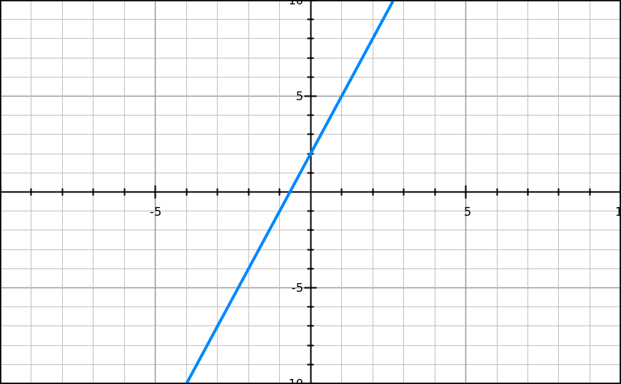
Do Now – (10 +1), (5² + 2), (4² – 6²)
Please respond to the following SILENTLY & INDEPENDENTLY:
Which linear equation best represents the graph?
y = 3x +2
y = 3x – 1
y = 3x – 2
y = 3x + 1
Plot the following equation: y = -3x + 2

Slide 27
Today’s Objective
SWBAT convert equations into proper slope-intercept form and identify the y-intercept and slope.

Slide 28
Converting from Standard Form to Slope Intercept Form
Before we convert equations into slope intercept form, we have to remember a few things about the slope-intercept form equation.
Key things to remember! (when written in slope-int. form)
1) The number attached to the “x” is always the slope!
2) The y should be alone! (no 3y or 2y!)
3) The number not attached to the “x” or “y” is the y-intercept!

Slide 29
Example 1
Identify the slope and y-intercept.
Follow along as I walk through this one.
y – 8x = 2

Slide 30
Example 2
Identify the slope and y-intercept.
Follow along as I walk through this one.
-8y – 4x= 16

Slide 31
Example 3
Identify the slope and y-intercept.
Follow along as I walk through this one.
-4x + 2y = 10

Slide 32
Example 4
Identify the slope and y-intercept.
Walk me through this one.
4x = 2y + 7

Slide 33
Example 5
Identify the slope and y-intercept.
Walk me through this one.
7 = -2y + 6x

Slide 34
Example 6
Identify the slope and y-intercept.
Walk me through this one.
y = 9 +x

Slide 35
Example 7
Identify the slope and y-intercept.
Work on this one with your partner.
24y + 8 = -48x

Slide 36
Example 8
Identify the slope and y-intercept.
Work on this one with your partner.
2y + 4x = 20

Slide 37
Example 9
Identify the slope and y-intercept.
Work on this one with your partner.
27y = -9 +18x

Slide 38
Example 10
Identify the slope and y-intercept.
Work on this one on your own.
6x = 10y - 8

Slide 39
Example 11
Identify the slope and y-intercept.
Work on this one on your own.
21x = 7y - 14

Slide 40
Example 12
Identify the slope and y-intercept.
Work on this one on your own.
60x = 20y - 80

Slide 41
Exit Ticket
Identify the slope and y –intercept: y = -½x – 7
Convert into slope intercept form: 8x = 4y – 24
Convert into slope intercept form and then identify the slope and y intercept : 8x – 2y = -4

